Slide 1
With the term smog we mean a mix of "smog" and "fog", which usually comes from burning coal, it refers to the aspect of the London atmosphere. Today, however, this type of smog occurs very rarely. Smog has always been harmful to the health both of the human beings and the animals and plants. It is the main cause of the problems related to lunges and to the various kinds of cancer. But the real question is: " HOW CAN WE PREVENT SMOG?"
WHAT IS SMOG?

Slide 2
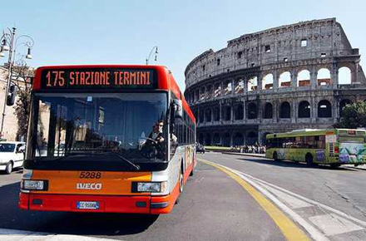
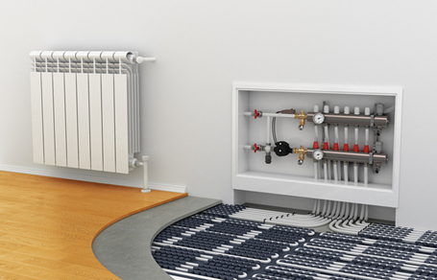
Italy
Italy's pollution comes from its urban activity, and it mainly concerns domestic heating and transportation. Knowing this, some instructions have been thought of to limit smog pollution in all Italian cities over a long period of time.
Making public transport more efficient, reliable and faster is a top priority because of the negligent use, and old vehicle usage should be lowered to lessen the very toxic emissions.
More sidewalks should also be integrated in the design of cities to further reduce the usage of vehicles.
Domestic heating is also a problem for its inefficiency in burning fossil fuels, so that is to be looked into.

Slide 3
What is the policy of the Polish government towards SMOG and related environment? And what policy do other European countries run against SMOG?

Slide 4
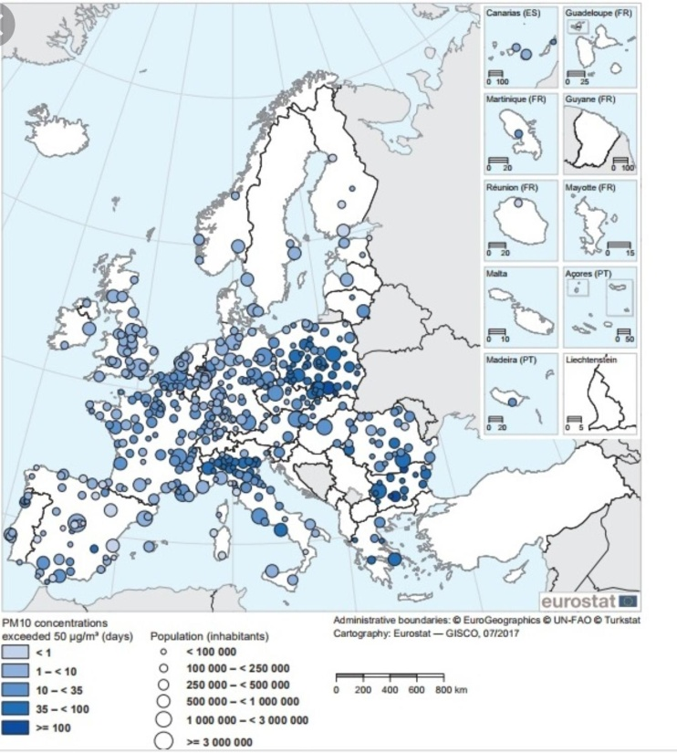
Poland is one of the most polluted countries in European Union: it is home to 33 of the top 50 most polluted European cities and every year die 50,000 people because of SMOG.

Slide 5
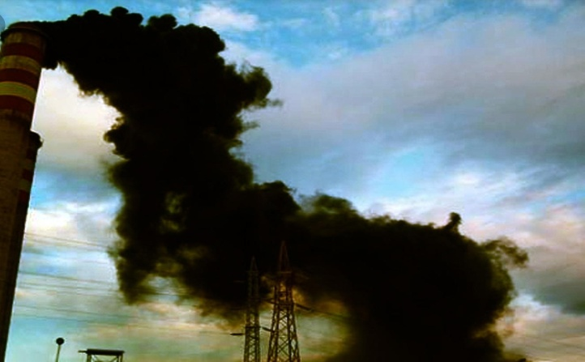
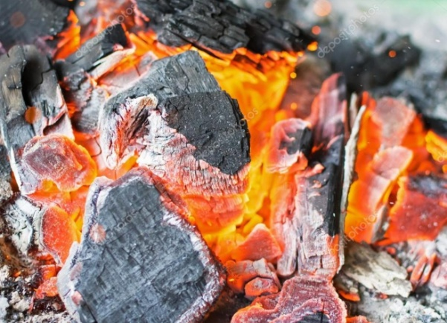
SMOG in Poland is caused by the use of coal to cook and to heat up and there are five coal factories with carbon dioxide which is the most dangerous in the EU.
For these troubles people get sick and they have to pay for cures, moreover air is contaminated.
A part of the government promises new rules and plans to fix this situation, but it still defends coal emission and production.

Slide 6
Also Europe is polluted, for example Italy is the second country in the EU where a lot of people die because of particulates like ozone, but the most damaged country is Germany. The European Union the 18th of December 2013 made the plan ”Clean Air for Europe” and was focused on the reduction of pollution for helping people, their health and the air.
In 2015 the government decided to apply medium combustion system in according with the Parliament.

Slide 7
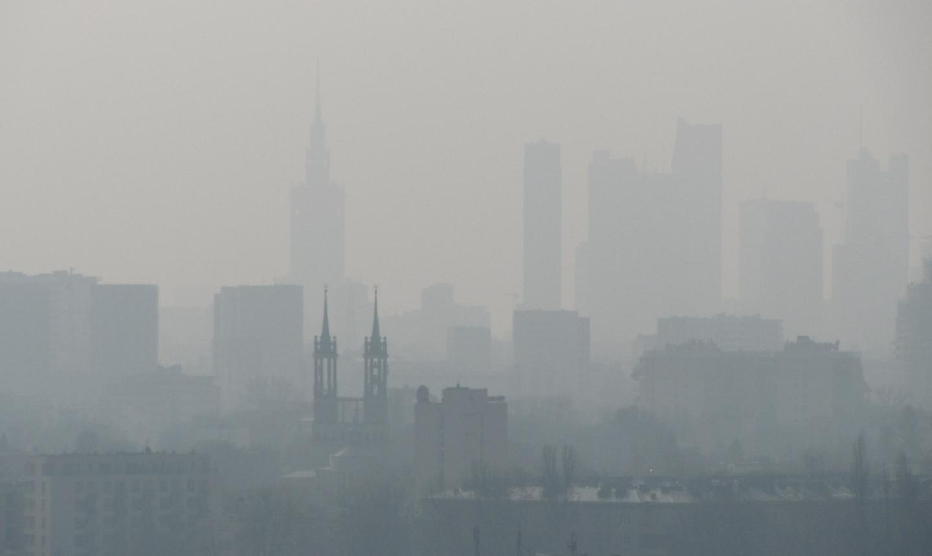
But now Poland is violating this directive, because the government is just interested in coal production.
Indeed Denmark wants to become the first neutral capitol for particulates thanks bycicle use within 2015 and in 2019 Spanish government decided to eliminate old cars to improve air pollution.
Greek government wanted to substitute stoves with chimneys, but this idea increased deforestation and pollution.

