Slide 1
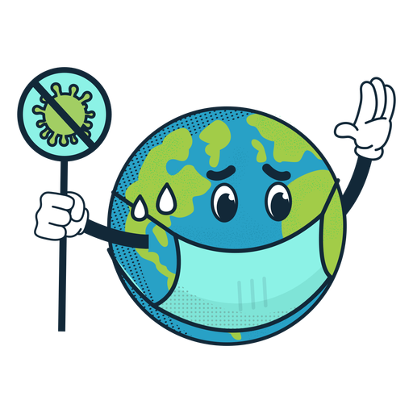
Our life now and before Pandemic
Presentation made by group 1

Slide 2
ITALY
This difficult situation had an impact on everyone, but since we all had to deal with what happened, the students reacted mainly the same way.
Everyone is sad, thinking about the possibility of not meeting friends and other members of the family.
Are there any country-differences how the students react?

Slide 3
ITALY
What have the school and society done?
Schools adopted online lessons, which are a valid alternative to lessons in the classroom, to still guarantee the right to study.
In Italy it is compulsory to wear masks even in public areas with a lot of space, to prevent the spread of the virus
About society, here in Italy, many voluntary associations organised some donations which offered food to people who couldn’t afford it, because of the hard economic situation that this pandemic caused. Some people did it also with other necessary goods in this period. For example a group of people, took the initiative to donate tablets or computers to children and guys who did not own them, to allow them to follow online lessons

Slide 4
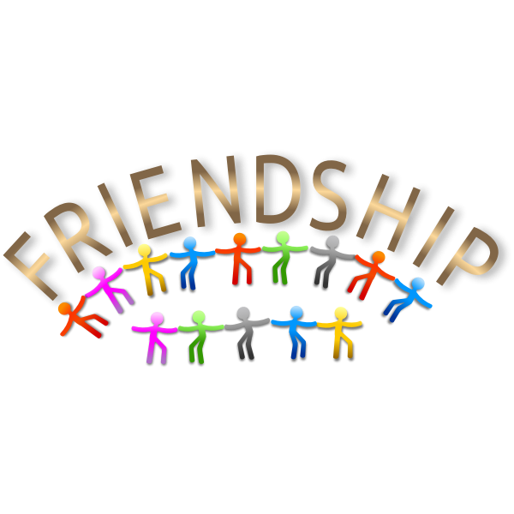
ITALY
Many of us developed problems of socialization with friends and especially with people we have never met before. When we are with them, we don’t know what to talk about, and what to do, but before we didn’t have this difficulty. The cause of this problem is that we just have contact with people through socials, and we are no longer used to spending time with friends.
About emotions, we noticed that during this pandemic we did nothing different, nothing extremely funny, it’s all very static, and we think that in static moments like these we can’t feel new emotions.
About behaviour, instead, we think stress makes us be more crabby with people with whom we live. There is not a peaceful environment, because everybody is in conflict due to the nervous situation we are living in.
Which effect has covid-19 had on behavior, emotions, social life?

Slide 5
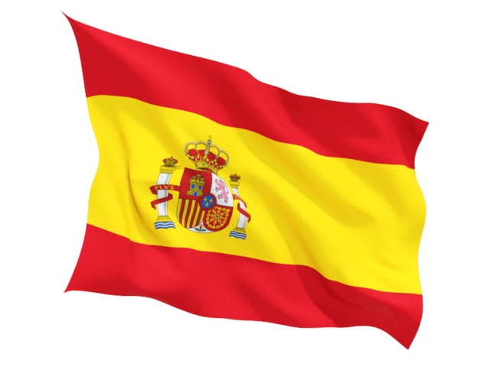
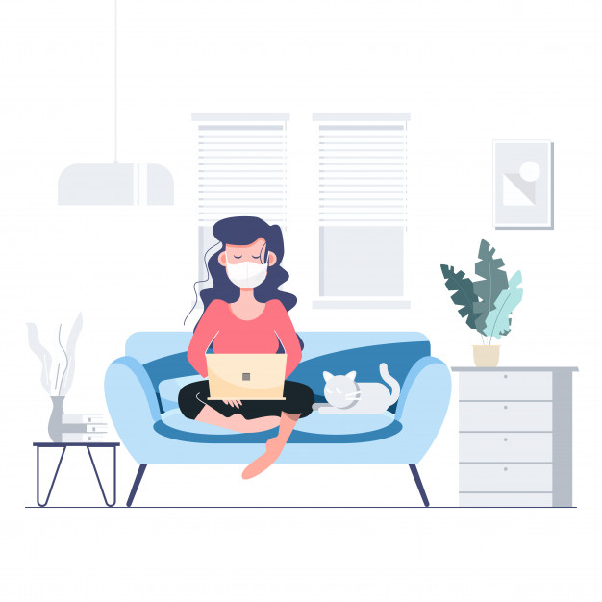
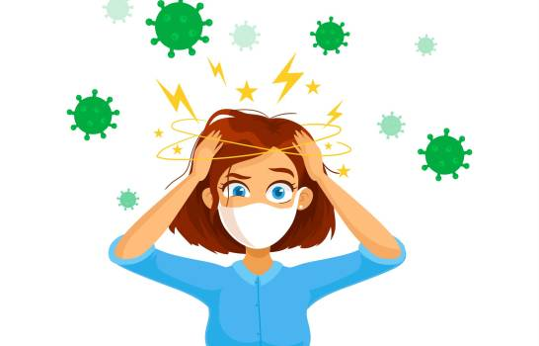
Spain
ARE THERE ANY COUNTRY DIFFERENCES ? AND HOW THE STUDENTS REACT?
As we all have been dealing with the same situation, the reactions from students were almost the same, but we can find some differences between them, because some of the students have been more time in quarantine at home than others, so it might have been more stressful and difficult for them.
Because suddenly, a lot of people from all over Europe had to get used to online classes and reduce their social life.

Slide 6
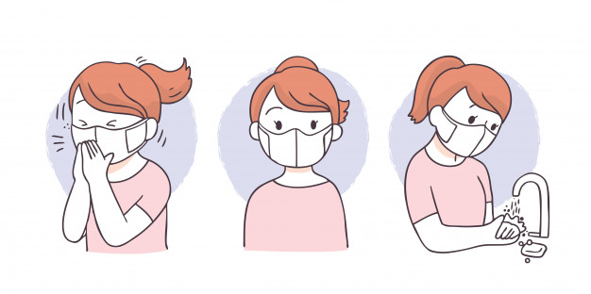
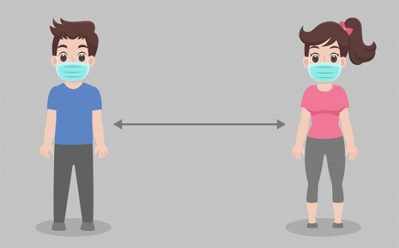
Spain
WHAT HAVE THE SCHOOLS AND SOCIETY DONE? DECREASE IN DEPRESSION?
At the beginning of the pandemic, the school was online since the virus and its effects were unknown, so it was better for the students to stay at home.
And now, with the new school year that has started, students in Spain are going to class, but with a lot of measures; all students must wear a mask all day, keep social distancing with separate tables and wash their hands regularly. Also at lunch time, it is preferable to avoid large groups of people.

Slide 7
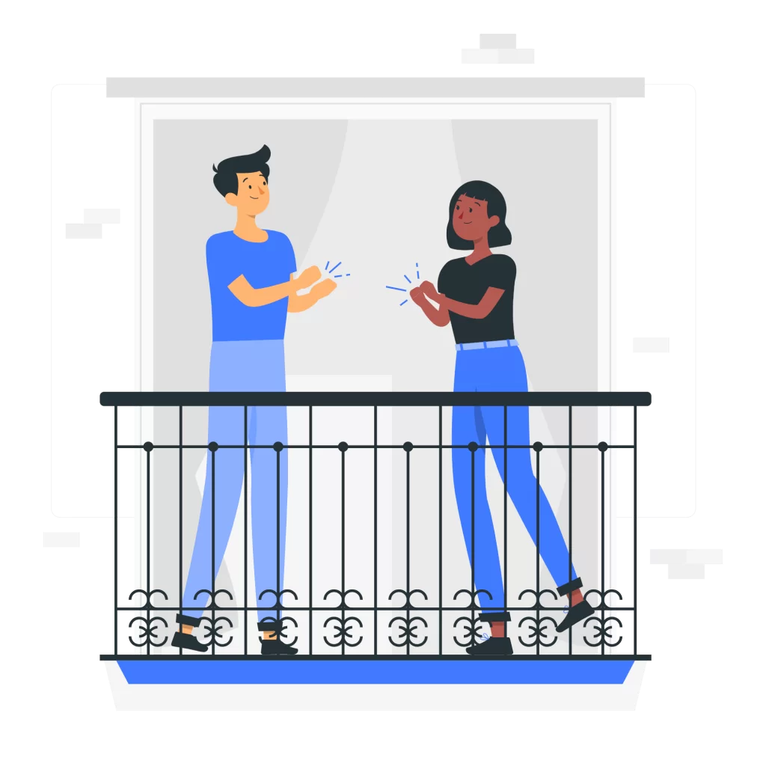
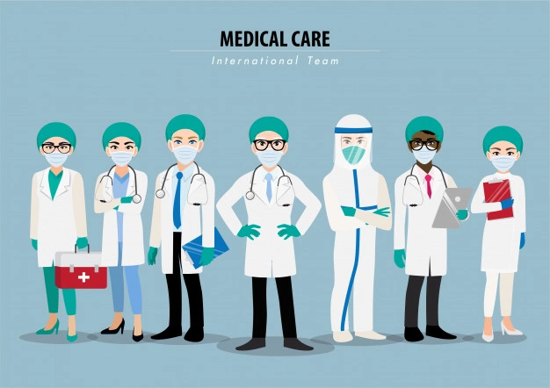
Spain
WHAT HAVE THE SCHOOLS AND SOCIETY DONE? DECREASE IN DEPRESSION?
Also in lockdown, every night at eight o’clock, everyone leaned out of the windows and balconies to applaud those sanitarians for their efforts during the toughest moments of the pandemic.
About society, a lot of organisations donated goods for poor people, and doctors were volunteers to work extra hours without earning any money, but to save more lives.

Slide 8
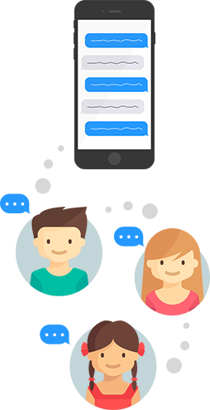
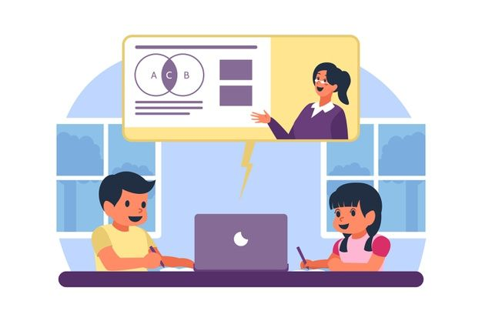
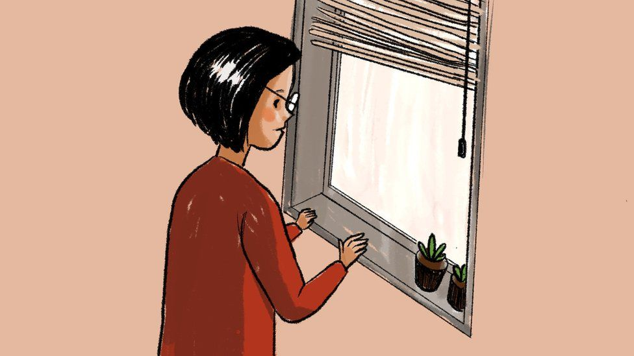
Spain
WHICH EFFECTS HAS COVID-19 HAD ON BEHAVIOR, EMOTIONS, SOCIAL LIFE?
The Covid-19 arrived in an unexpected moment, so nobody was mentally prepared. Maybe the first two weeks of quarantine were easy, but after two months, everyone had to deal with loneliness.
Also students, were more stressed about school, as the evaluation system was going to change, and they continued with school without knowing how they were going to be evaluated. Also, it was hard for them not to see their friends every day, but at least, thanks to new technology, they were able to communicate with each other.

Slide 9
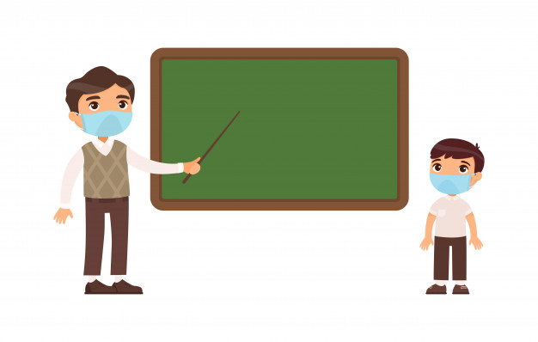
Poland
Are there any country-differences how the students react?
Without a doubt there are several differences between how students react all over the world. But mainly we react in the same way. For example, most of us look after our families and closest friends. Each of us tries to deal with the virus in our own way.

Slide 10
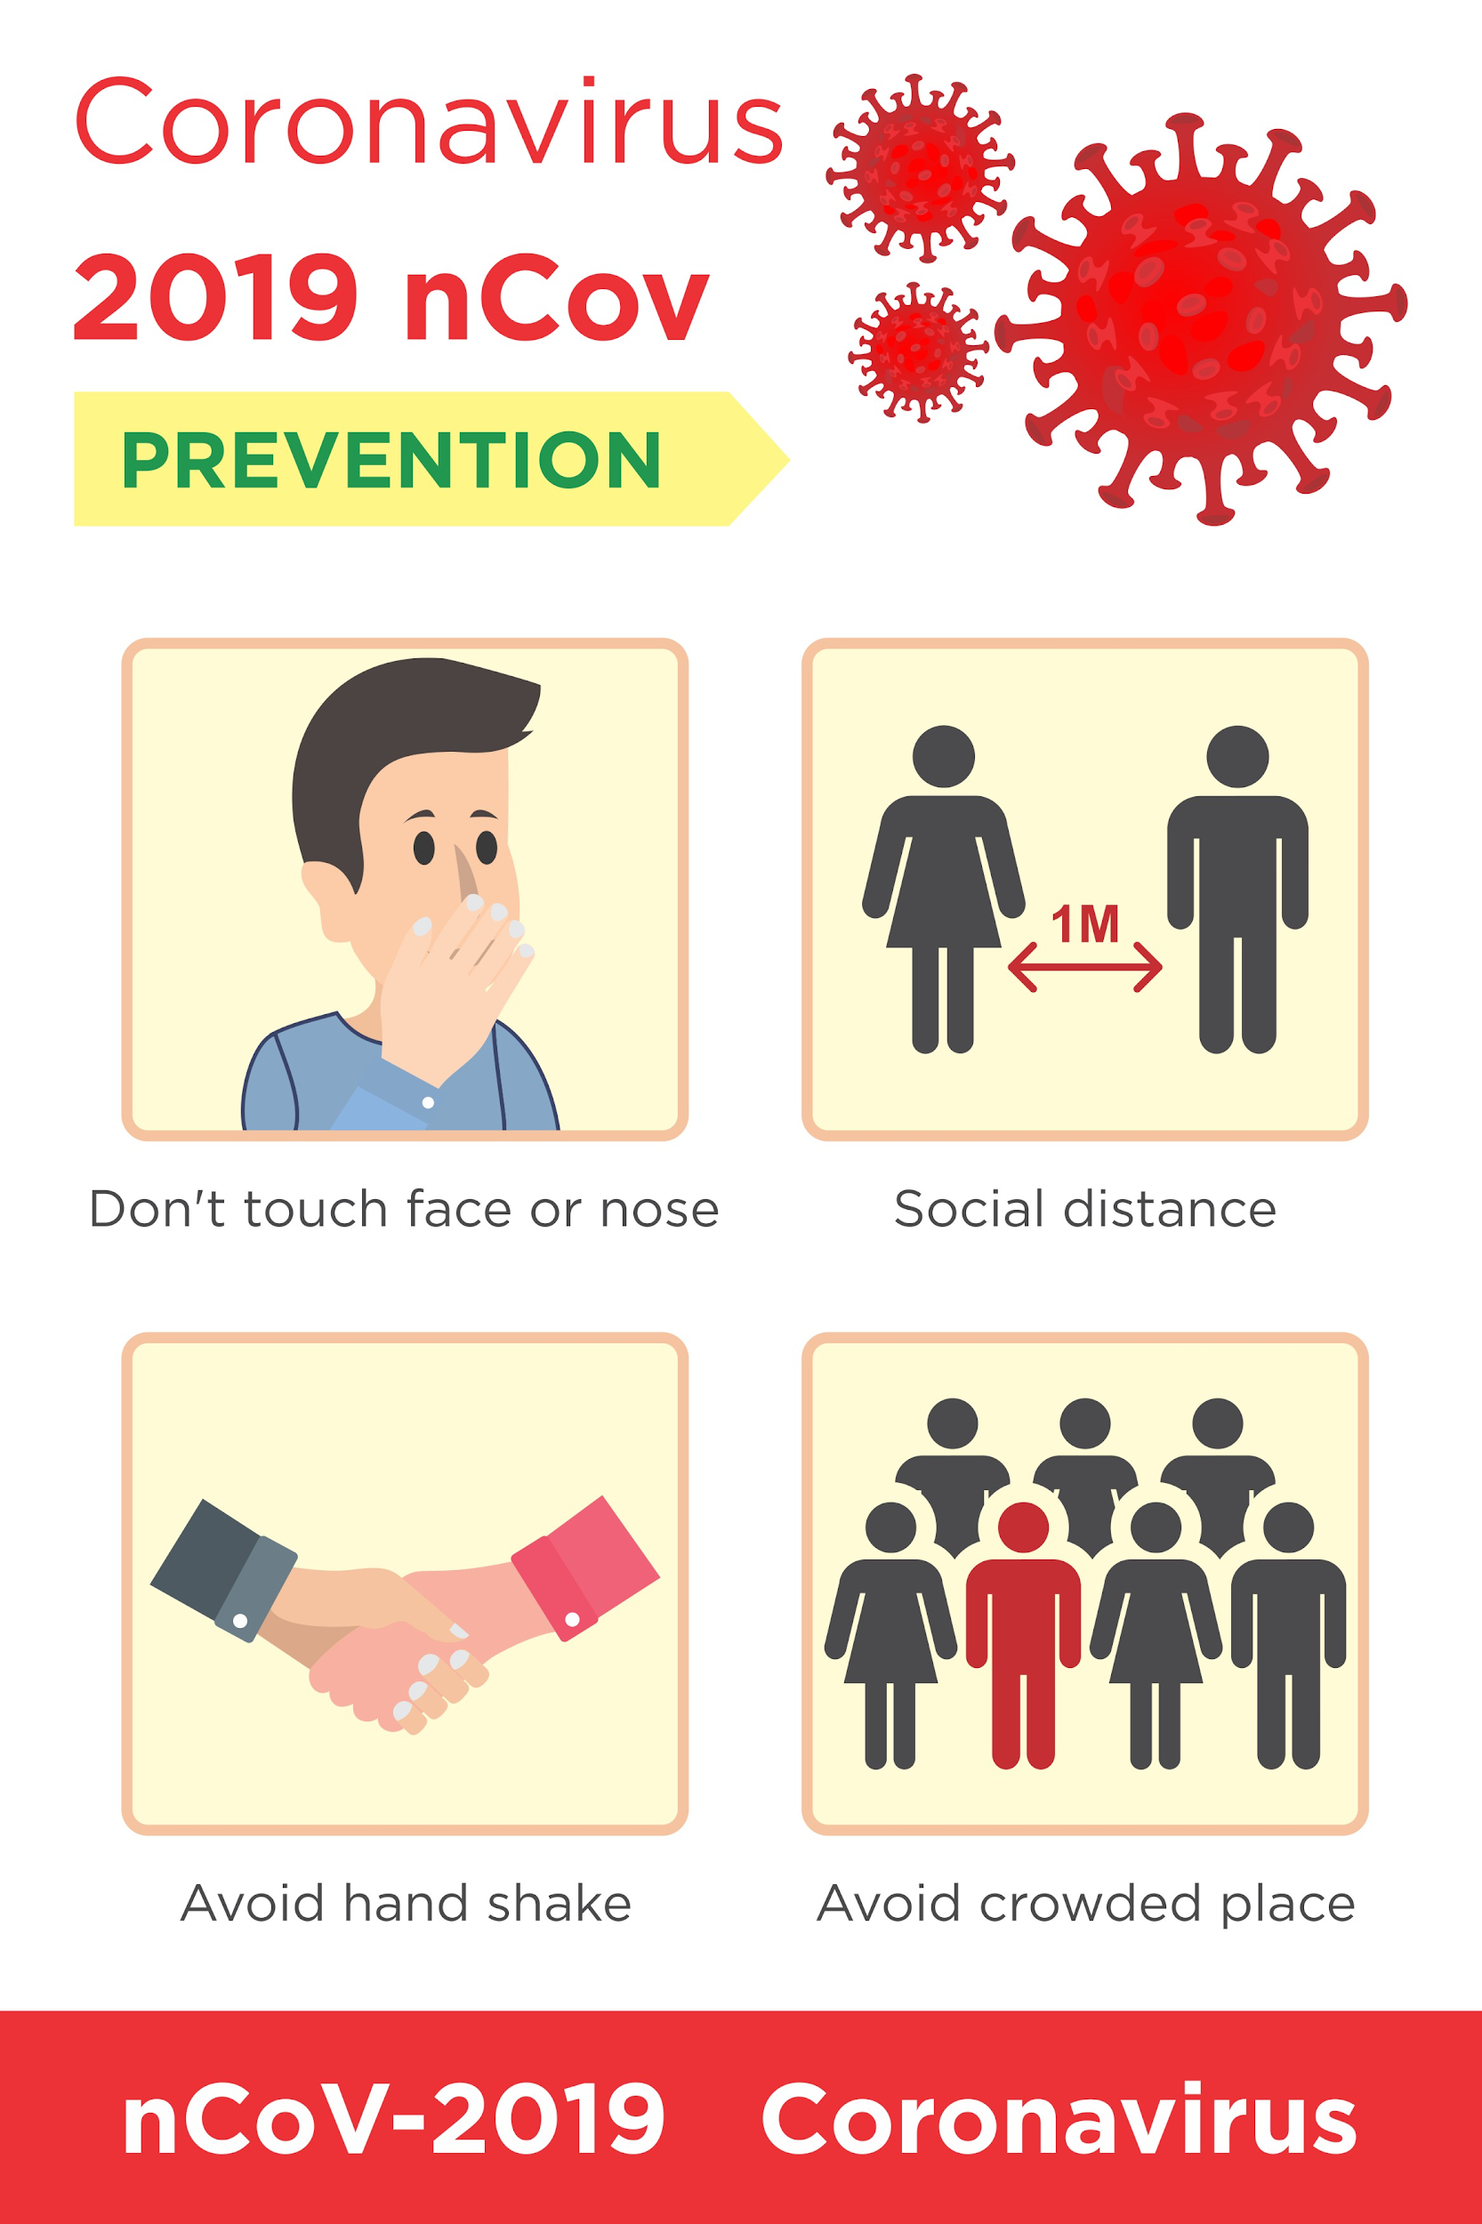
Poland
What have the school and society done?
In order to prevent Coronavirus from spreading society in Poland have started to wear face masks and we are trying to keep social distance. What's more, a lot of places are being built to keep your hands clean. Schools also took a few steps to stop the coronavirus spread. As an example, schools have started e-learning due to the fact they were closed in October. We hope the steps that have been taken will make the society contribute faster to putting an end to the pandemic.

Slide 11
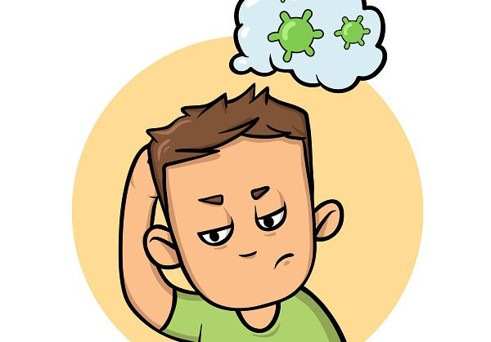
Poland
Which effect has covid-19 had on behavior, emotions, social life?
Initial downplay turned into global anxiety.
It is the first time since the spanish flu humanity has struggled again with a pandemic. We have been locked in our homes for long. We have been apprehensive and watched with concern what will happen in the future. Everyone at least once during the pandemic time has experienced something that deeply touched them. For instance, lots of people started to abuse alcohol. Relationships between people have also deteriorated. I guess our behaviour has not changed.

Slide 12
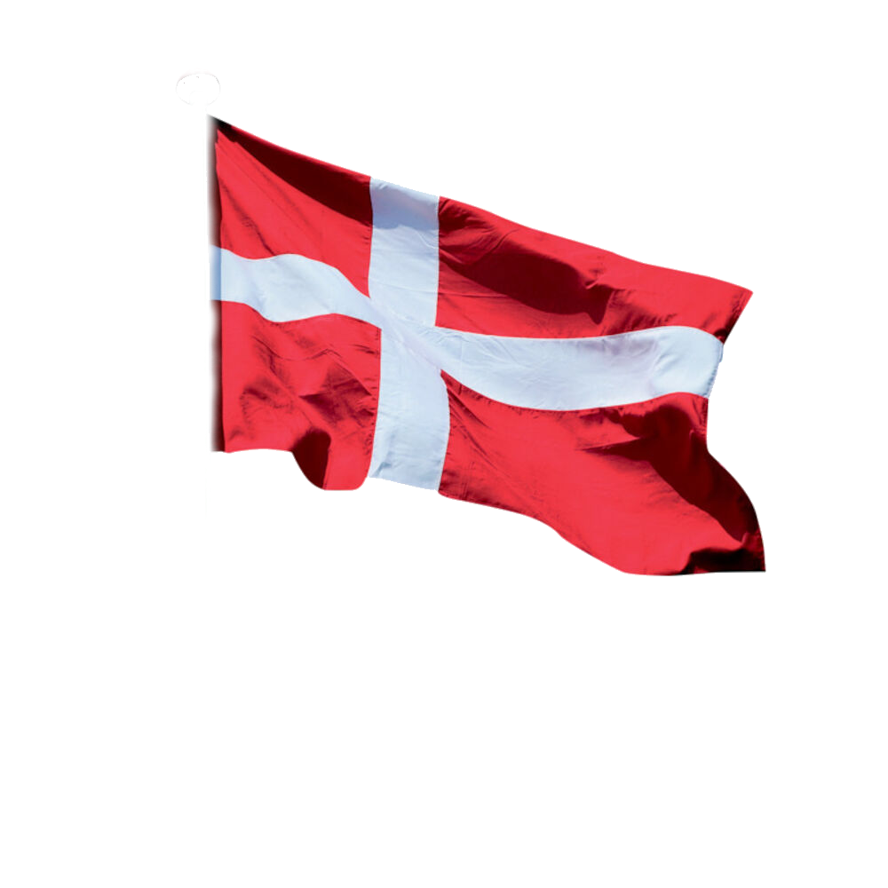
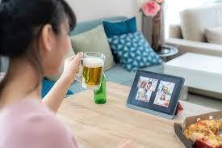
Denmark
What have the school and society done?
In Denmark, we don’t think that our school has done so much to specifically prevent depression, but our school had planned some virtual meetings for each class. For example, there are once a month something we call "fredagscafe", which is a Friday afternoon where we can stay at the school and drink a few beers or just be with our friends, but because of corona we were not allowed to, so instead the school planned a virtual meeting for each class, so we could be at home, but still have a good time with our friends.

Slide 13
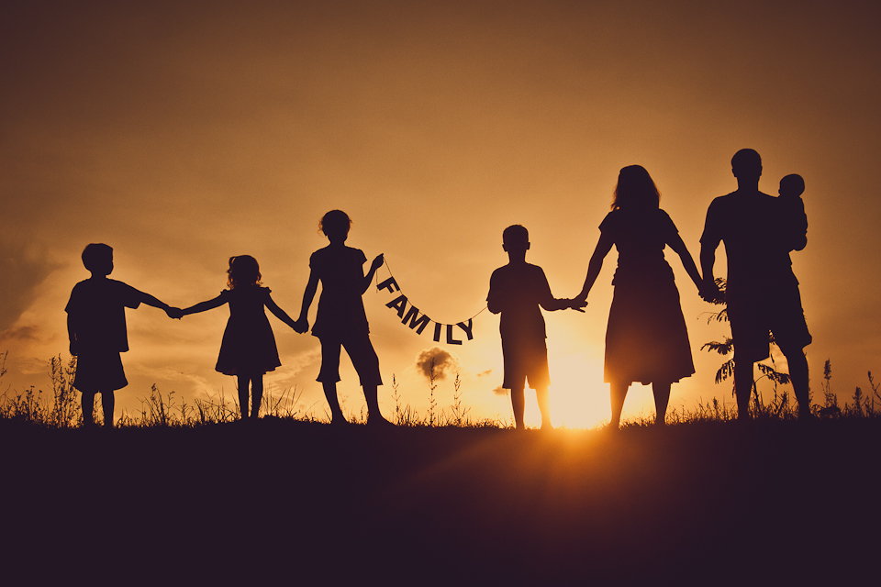
Denmark
Which effect has covid-19 had on behavior, emotions, social life?
We think that the effect of covid-19 has been that we all realized how much we took for granted. Before covid-19 things like going to school, visiting grandparents, or travelling around the world, were not things that we appreciated so much. Going to school does really such sometimes, but we found out that it is not something we would be without.

Slide 14
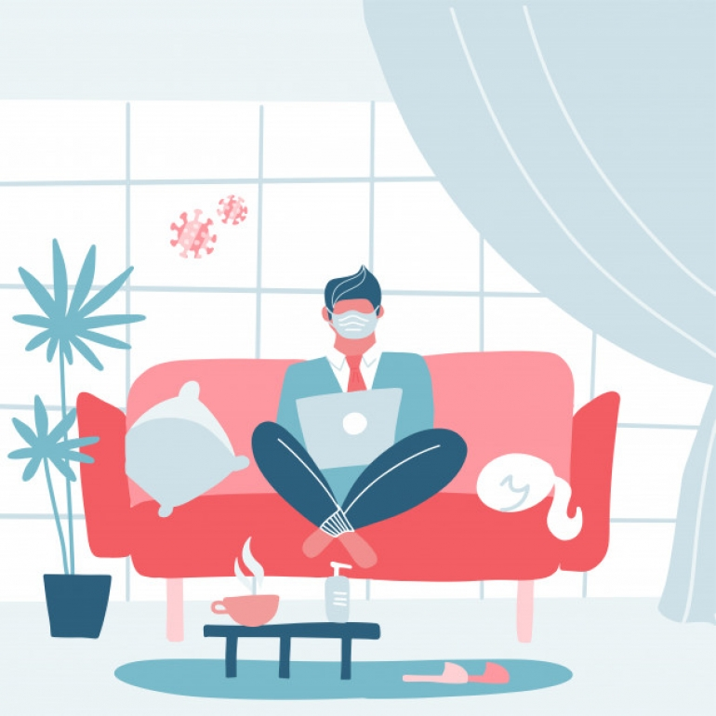
Greece
Mainly, countries all around the world are working almost the same way. Students have been cautious so they avoid getting in touch with their friends and even their family. Covid-19 has been harsh and difficult for every student to deal with, especially in Greece where the weather is good and cold weather is something uncommon. At first there was a depressing environment in every student’s head because we were locked in our homes but now that time has passed, everything and everyone has come to a relaxation
ARE THERE ANY COUNTRY DIFFERENCES ? AND HOW THE STUDENTS REACT?

Slide 15
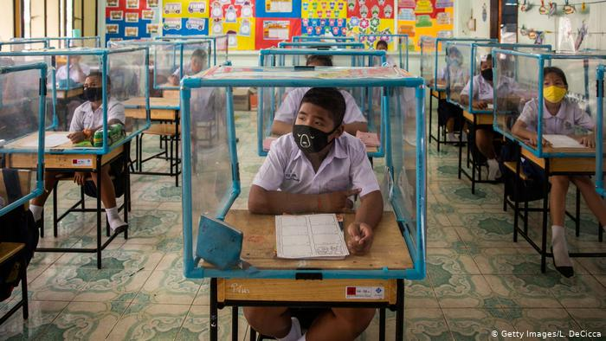
Greece
What have the school and society done?
Greek schools have led to online lessons where the teaching hours have been decreased so the students wouldn't spend so much time in front of a screen.
Our government decided to put us in quarantine and we all have to send messages to get out of our house. Also, we are only able to leave our house from 5am to 9pm. If any person breaks these rules then he/she has to pay a fine

Slide 16
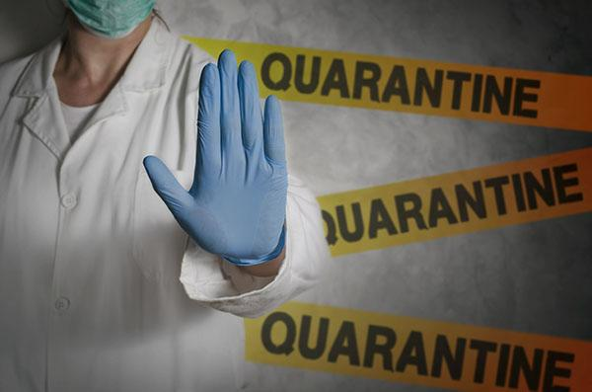
Greece
Covid-19 has affected our behavior and we have become more introvert so we don’t express our feelings as much as we used to. This has led to the conclusion that more and more people are getting daily more depressed. Everyone tries to communicate with others by social media since we cannot talk to each other face to face. We are trying to receive the feelings that we would have had if Covid-19 didn't exist and everything was normal but obviously there are some who cannot get the result they want to
Which effect has covid-19 had on behavior, emotions, social life?

