Slide 1
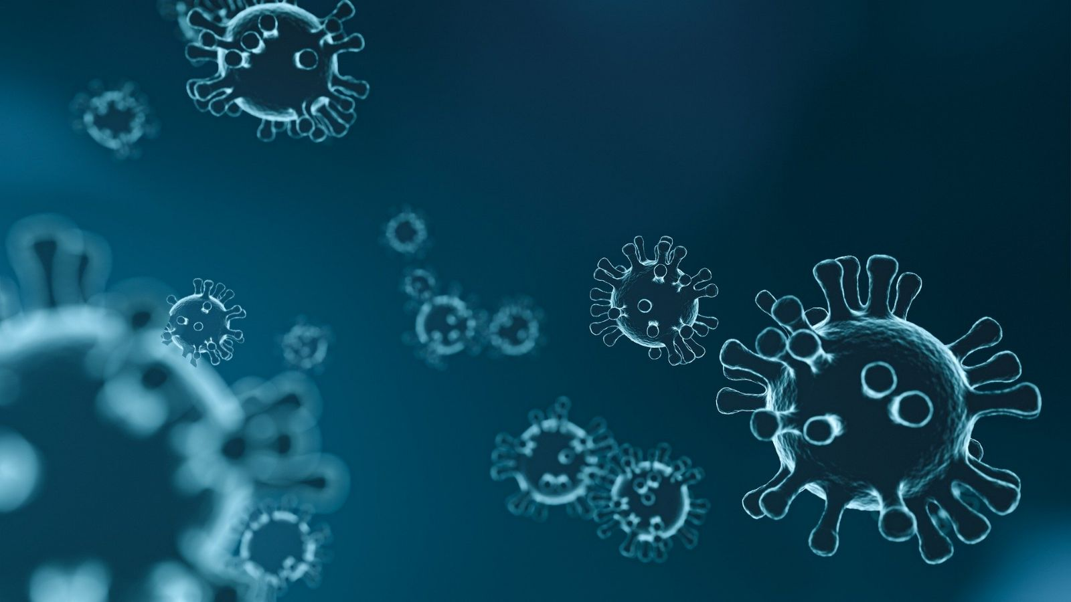
Corona everyday life.
Group 2

Slide 2
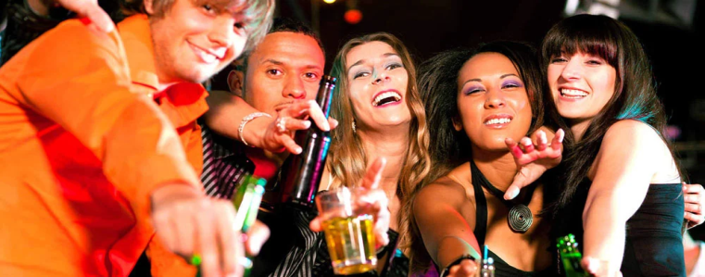
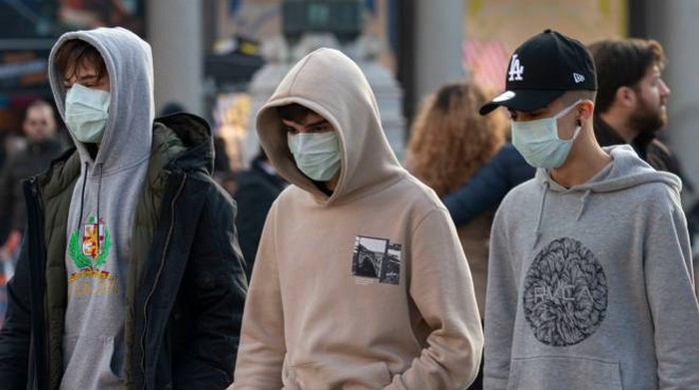
Differences between before and after
covid-19
With the emergency of Covid-19 there have been many changes in the lives of all people. Habits, school, sports, work and other activities have suffered very serious damage. For almost a year, the whole world has been fighting the coronavirus pandemic and trying to end its problem as soon as possible. The world's greatest powers have made research a priority to protect the population. We must wear masks to protect ourselves and those around us. Before the virus everything was normal, it was permitted to go to a bar with thirty people, to go to a big party in a house or to see your family and kiss your grandparents, it’s not easy for us teenagers because have always been used to hanging out with our friends every weekend and to be with lots of people in a bar, now that’s impossible.
BEFORE
AFTER
Notes:
AFTER

Slide 3
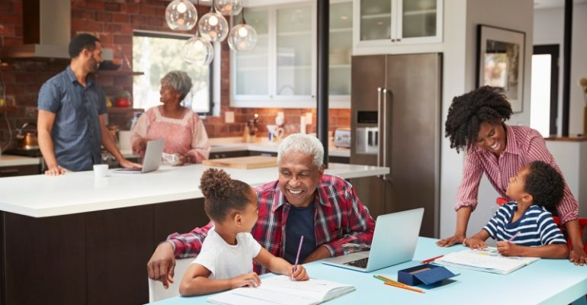
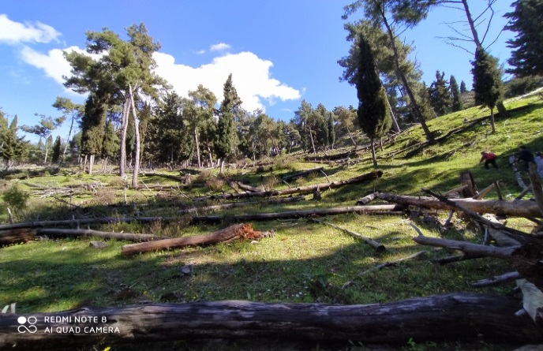
On the other hand, there are advantages, too. When we had the lockdown, time stopped and we saw things that could never been seen under the pressure of routine. We started spending time with our families, we visited the countryside to get exercise and notice the beauty of nature. We observed what there was outside our windows and the whole change of seasons. Everything was there but we had never noticed it.
In conclusion, Coronavirus is a horrible and deadly virus but apart from these disadvantages there are some advantages. Without this condition we would never experience the good part of life.
Our lives are unavoidably different in the wake of COVID-19, and they are likely to stay that way until the outbreak is contained or treatments and vaccines become available. This is what our lives look like now. February feels like it happened a long time ago. But it is not all disastrous. We are newly appreciative of the things we’ve happily jettisoned along with our routines, the things we miss having in our lives, and the ways we’ve adapted to keep joy, connection and fresh possibility in our lives.

Slide 4
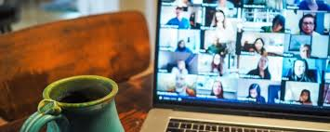
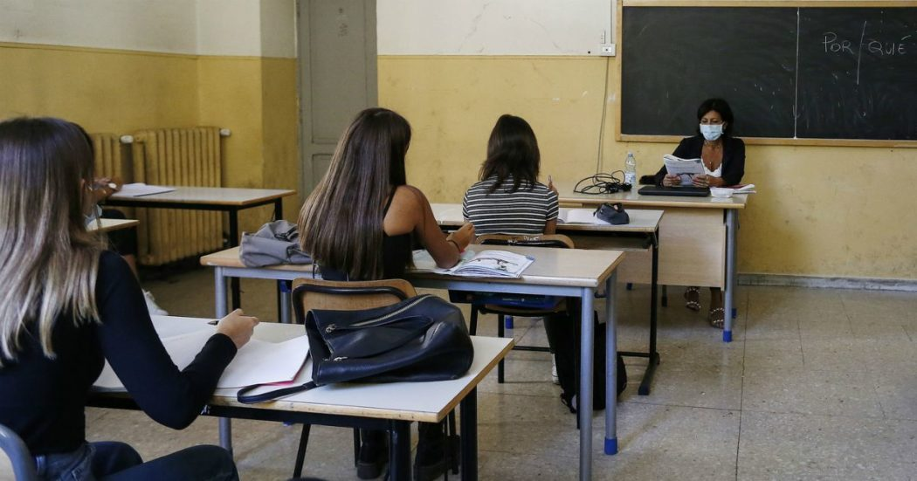
Country- differences how the students react
One area that has been hit hard is education. Students had to switch to online learning or those who continue to go in attendance must also respect the restrictions here. It was a very difficult period. Permanent sitting in front of the computer is very tiring and painful for the eyes. Not being able to leave home or meet friends was very sad. Fortunately, thanks to the development of the Internet, we can easily contact others without leaving home. It leaves all the pupils a bit of nostalgia and a bitter taste in the knowledge that they cannot see teachers and classmates. In fact, going to school was taken for granted and we would never have imagined such a complicated situation. The school has implemented security measures, and it helped the students when they were in quarantine to reach the level of knowledge that is necessary for the next school year. The coronavirus has affected us equally, despite the fact that we all come from different parts of Europe, with no substantial differences.

Slide 5
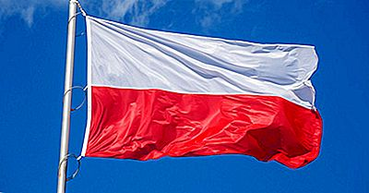
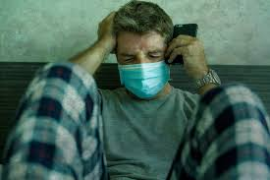
What have the schools and society done? Decrease in depression?
In Poland:
The Polish government continues to introduce new restrictions. It has decided to extend the lockdown in the gastronomy, culture and fitness sectors. Restaurants, cinemas, theaters, and gyms will remain closed. Shopping malls reopened under strict sanitary regulations and with customer limits. However, the schools in Poland remain closed (remote learning).
The COVID-19 pandemic takes a significant toll on the mental health of young people. Young people in Poland have struggled mostly with feelings of loneliness, isolation, boredom and mental exhaustion. The younger respondents have found it especially hard to deal with movement or travel restrictions, isolation from family, friends or other people in general, monotony and restrictions on their liberties. Others mentioned difficult family relationships and a lack of personal space at home as the cause of their problems.

Slide 6
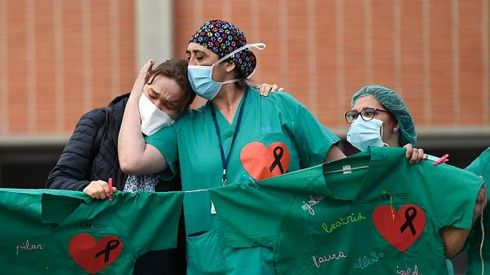
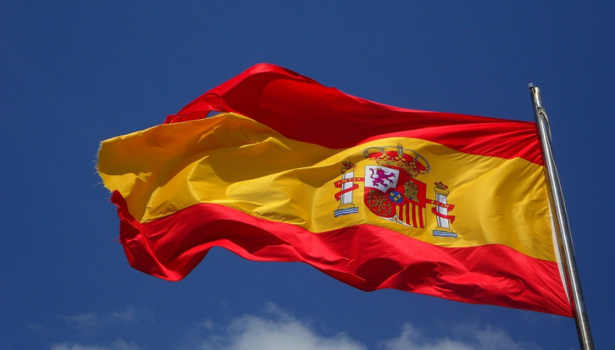
In Spain:
in the school everything is different now, you have to bring with you the disinfectant gel wherever you go and in the breaks the children are not allowed to play with the ball, everything has changed.
The school has implemented security measures and they have helped the students in quarantine.
The Spanish society has shown a feeling of solidarity that they don’t know that it was there. When the virus ends we will be the happiest people in the world.
When the pandemic started everyone was confused, it was something new for most people and not being able to go outside was very hard for everyone. The lockdown caused a big psychological impact: depression, anxiety, fear, due to the isolation, loneliness, and ignorance that the situation entails.

Slide 7
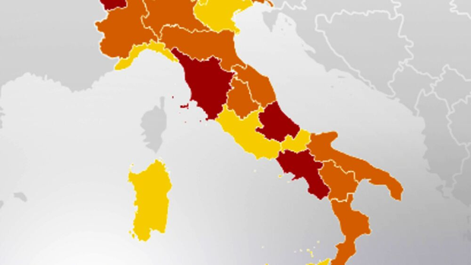
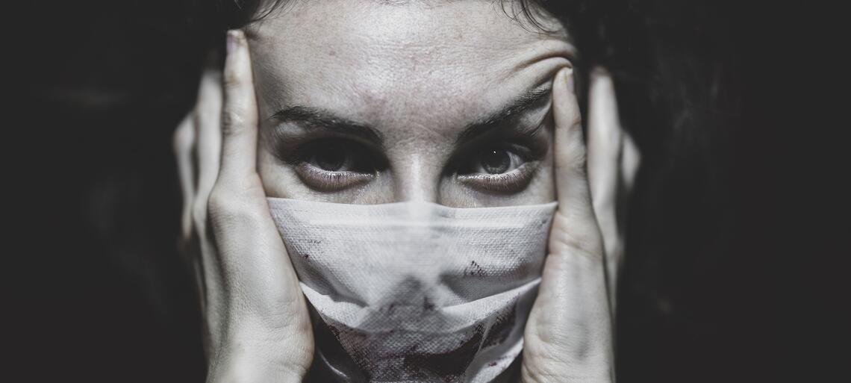
In Italy:
Our Italian government has tried to do everything possible
to address this difficult situation, has helped Italian citizens through the provision of bonuses and benefits, such as shopping vouchers, babysitting vouchers, discounts for shops.
Then our country was divided by the government into three colors: red zone, orange zone, yellow zone, depending on the situation, to contain the virus.
At first the students did the learning at a distance, during the quarantine the school moved on our computers and cell phones, the students followed the lessons from their rooms.
The coronavirus not only hit us from the outside but also from the inside, it hit our emotions, our thoughts, our hopes. It has changed us deeply.
He crushed us, left us empty, with little hope for the future.

Slide 8
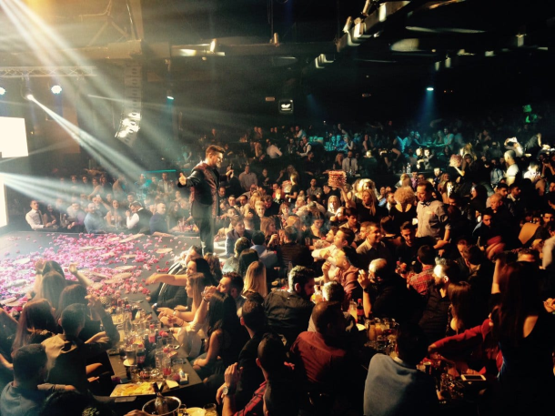
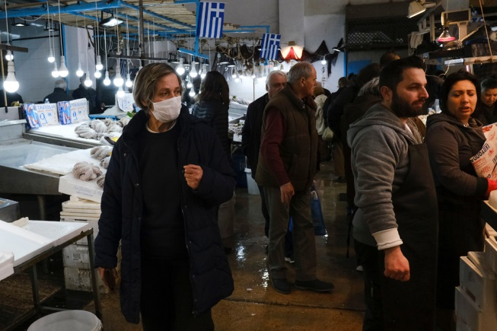
In Greece
Greece is a country famous for nightlife. People from all around the world were gathering here in order to have fun, go to <<Bouzoukia>> (which is a music center), or even taste delicious meals like Souvlaki or Tzatziki, in local restaurants called <<Taverna>> . Is such a shame that our government had canceled all those activities. And that is only the beginning. Our routine as teens has changed completely.
School and activities were part of our life. Now the whole country is in quarantine and we can do nothing about that. But that is our reality and for the good of the society we must obey to the government.

Slide 9
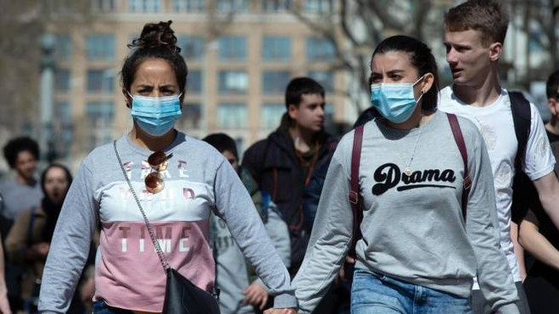
In Denmark:
In Denmark we are really affected by the Corona situation again. Mette Frederiksen our prime minister has decided to shut down Denmark again. All kind of schools are closed and we have virtual class, the bars, restaurants and so on is closed, and soon will all shoppingmalls be closed too, so it’s only the necessary stores that are open. Mette Frederiksen started the first restrictions the 9th of December, where it was only the big cities that were under lockdown. Now it’s all of Denmark and the last restrictions will be followed through the 25th of December to a least the 4th of January. The Prime minister described the coronavirus as very serious, because our number of infected is on the rise. Under half of the beds in the Danish hospitals are reserved for Corona patients, and it’s only people with severe illness who are allowed to go to the hospital and the doctor. Before the Corona Denmark was a very happy and open country, now people are living in fear and our distance to each other is extreme.

Slide 10
Effects of Covid-19 on behavior, emotions and social life.
As the pandemic progressed people began to adapt. We couldn't do many of the things that we used to do and it influenced in the emotions and social life. Some people now prefer to stay at home, with family or closest friends for the fear of contagion.
It is obvious that we became more careful and we followed restrictions put on us in the beginning of pandemic. We keep distance with other people, we wear masks and we wash hands. Every time we leave home we check if we took our basic stuff such as phone, keys, wallet and now a mask.
Our social life with no doubt has been limited to the minimum.
We have stopped going to cinemas with friends and all planned school trips or holidays had to be cancelled. We almost forgot how it is like to eat in a restaurant or pizzeria but we have got used to wait for the delivery.

Slide 11
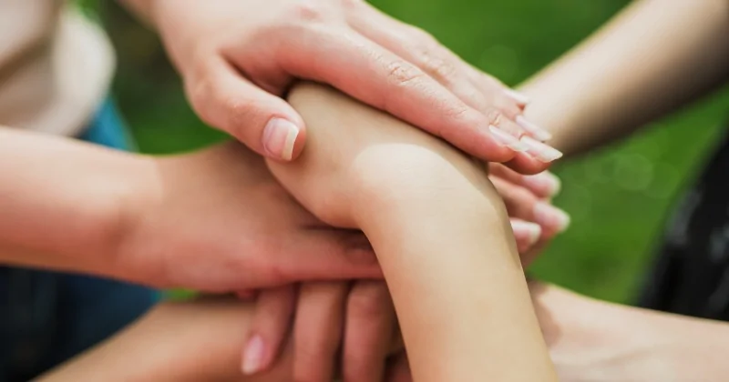
The virus is like a cage that separates us from freedom, so it really affected our way of being, and how to relate to others.
The only comfort is the fact that we are not alone in fighting this situation, the pain unites us and gives us hope and courage.
Even though we can’t be physically united, we’re emotionally united, we’re all in this bad situation, so we can give strength each other .

