Slide 1
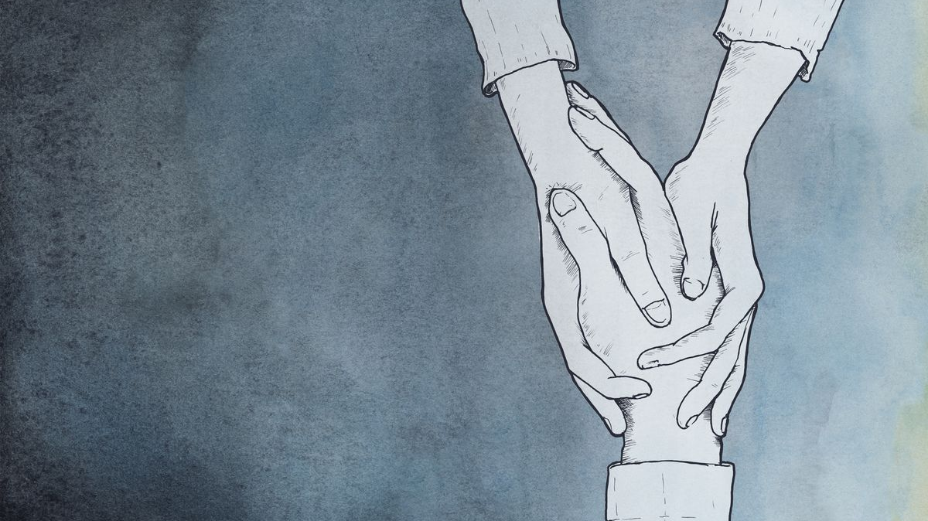
School policies on teenage depression
Group 3 (Denmark, Spain, Greece, Italy, Poland)

Slide 2
Depression statistics
350mln in the world
83mln in Europe
11% teenagers

Slide 3
Depression statistics in our countries
I T A L y | S P a I n | P O L A N d | G r E E C e | D E N M A R k
3 049 986 | 2 408 700 | 1 878 988 | 593 136 | 267 213

Slide 4
Is there a psychologist in your school?
DENMARK | ITALY | POLAND | GREECE | SPAIN
NO | YES | YES | NO | YES

Slide 5
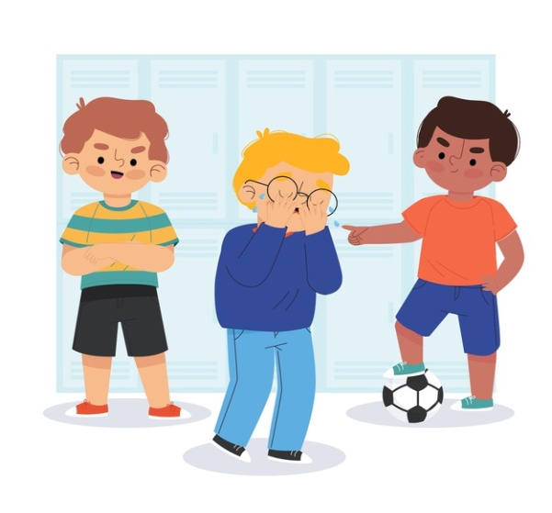
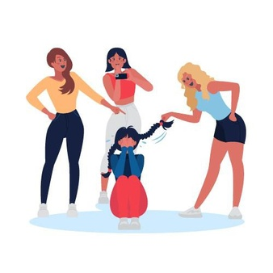
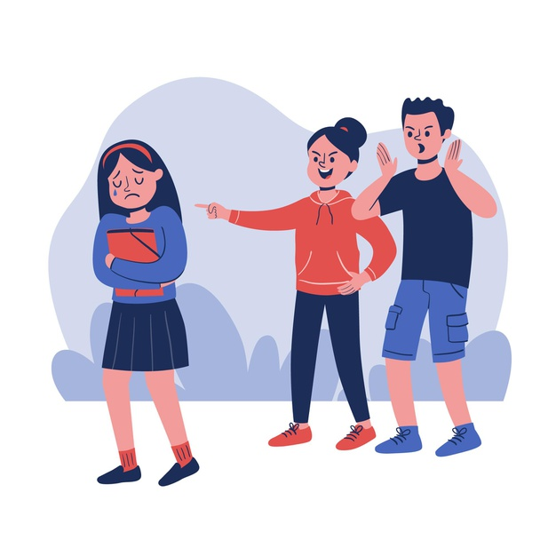
Main mental health issues
Bullying
Violence
Orientation
Misunderstanding
Problems at home
Stress

Slide 6
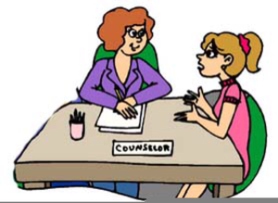
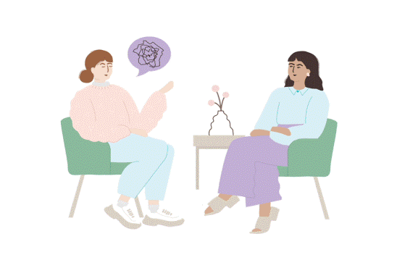
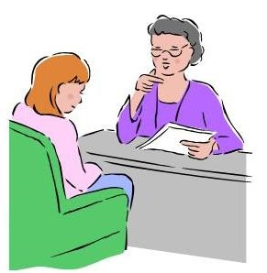
Steps taken by school when depression in recognized
SPAIN
the student who has symptoms of depression goes to the school psychologist, then the school sends this person to a psychological clinic, also informs the family and teachers
DENMARK
school itself doesn’t help with teenage depression, you can go to the school counsellor, but you will be directed to see a specialist
GREECE
if a student is suspected to have a depression, first parents are informed then the E.D.A.Y is called
POLAND
if depression is recognised, parents are informed, a student works with the school psychologist; the local psychological clinic which the school works with is informed
ITALY
you can attend a psychological desk where anyone can talk about their problems with a professional psychologist

Slide 7
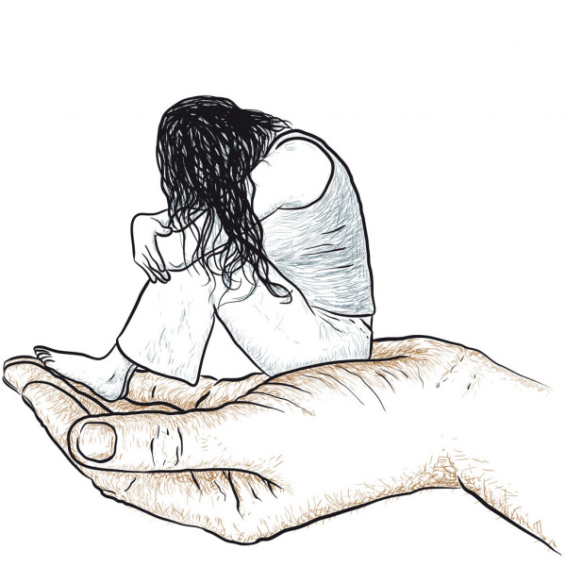
What is done to prevent it
Spain: there are only programs to prevent bullying
Italy: school provides a series of extracurricular activities, e.g. volunteering activities, which helps depressed and lonely student
Denmark: no special activities. There is a counsellor, who helps with school problems
Poland: there are workshops for teachers and special lessons with a psychologist for students
Greece: No specific activities taken by school

Slide 8
Is your school strategy effective?
SPAIN POLAND DENMARK ITALY
GREECE

