Slide 1
PRESENTATION ON SMOG
Nikos Papangelis & Komnenos Kostoglou
.

Slide 2
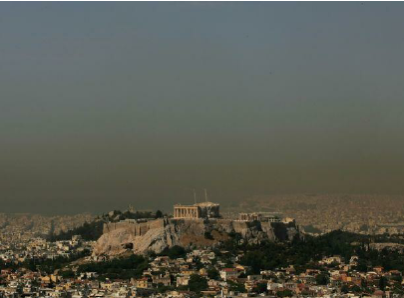
WHAT IS SMOG?
Smog is a type of air pollution that forms when photons find in their way molecules of air pollutants. The word was coined in the 20th century and is a combination of the word ‘smoke’ and ‘fog’.

Slide 3
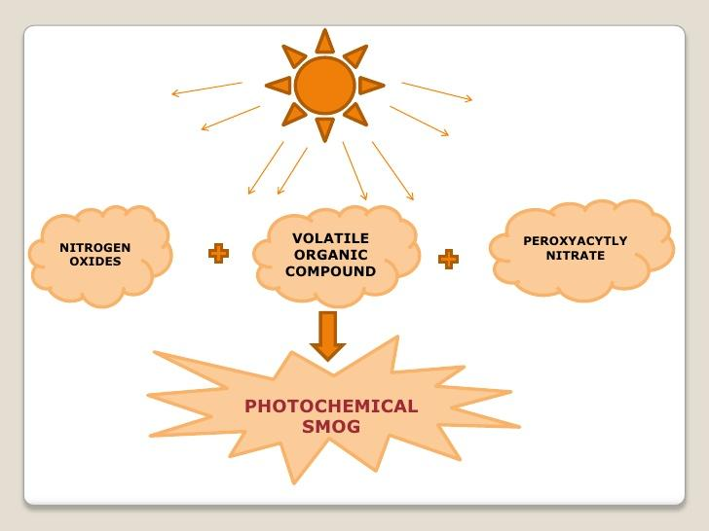
Nitrogen Oxide: comes from vehicles mostly.
Volatile Organic Compound: emitted from pesticide and paint.
Peroxyacetyl Nitrate or PAN is a byproduct of nuclear power plants.

Slide 4
HOW DOES IT AFFECT SOCIETY?
Health Effects: it inflicts pain, asthma, cough and worst case scenario even lung cancer when it is frequent.
Environmental Impacts: damages crops and tree canopies, destroys ancient structures.

Slide 5
MEASURES AGAINST IT
Limit use of personal vehicles
Reduction of the usage of coal and firewood
Avoid chemical painting materials
Reduce pesticide use (buy biologically grown food)
Fuel up during the night or early morning

Slide 6
HOW SERIOUS OF AN ISSUE IS SMOG FOR GREECE?
Greece ranks 70th worst in the world for air quality (out of 180 countries) for 2019.
For Kos, Smog is a mild issue only for summer days when there is little air and too many cars on the streets.
Greek cities that contribute heavily to smog :
1. Xanthi (Northern Greece) - due to power plants nearby
2. Athens - due to traffic
3. Thessaloniki
4. Patras
For Kos, Smog is a mild issue only for summer days when there is little air and too many cars on the streets.

Slide 7
SOURCES
https://www.slideshare.net/flash3110/photochemical-smog
https://www.thoughtco.com/what-is-smog-causes-and-effects-1204194
https://www.numbeo.com/pollution/rankings_by_country.jsp?title=2019
https://www.airvisual.com/greece

