Slide 1
How to prevent smog
Flavia Bastano, Komninos Kostoglou, Wiktoria Celejewska, Maciej Sobierański, Agata Kustosz, Milena Serafin

Slide 2
Measures
Drive less. Walk, bike, carpool, and use public transportation whenever possible.

Slide 3
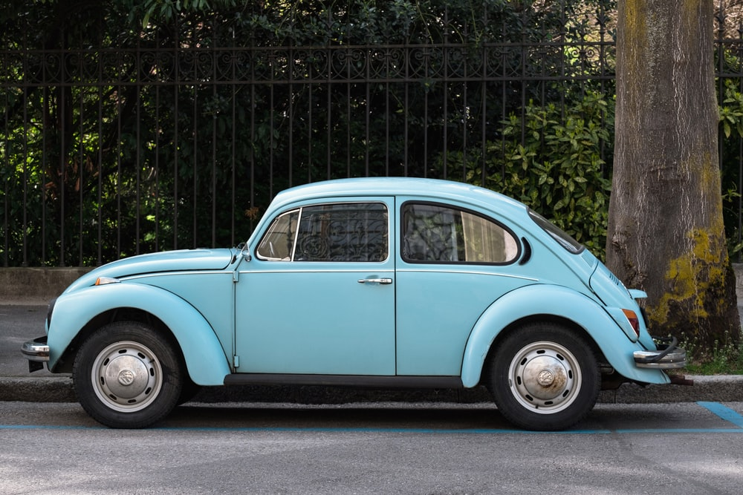
Measures
Take care of cars. Getting regular tune-ups, changing oil on schedule, and inflating tires to the proper level can improve gas mileage and reduce emissions.

Slide 4
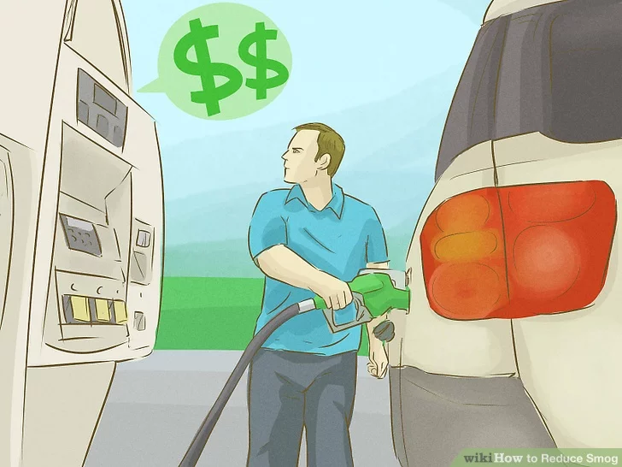
Measures
Fuel up during the cooler hours of the day—night or early morning. This prevents gas fumes from heating up and producing ozone.

Slide 5
Measures
Avoid products that release high levels of VOCs. For example, use low-VOC paints.

Slide 6
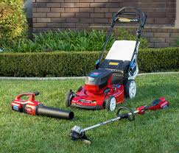
Measures
Avoid gas-powered yard equipment, like lawn mowers. Use electric appliances instead.

