Slide 1
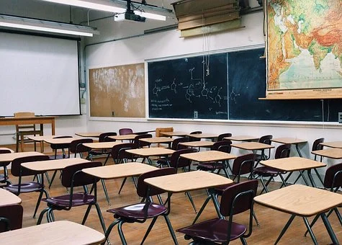
Our school as a second home

Slide 2
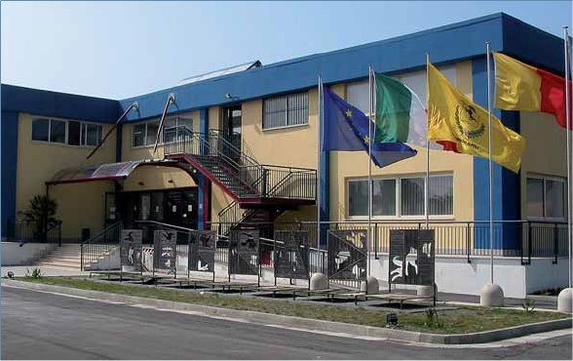
This is our school.
It is named “Liceo Statale “Don Lorenzo Milani” - Napoli” and it is located in San Giovanni a Teduccio the east suburban area of Naples.

Slide 3
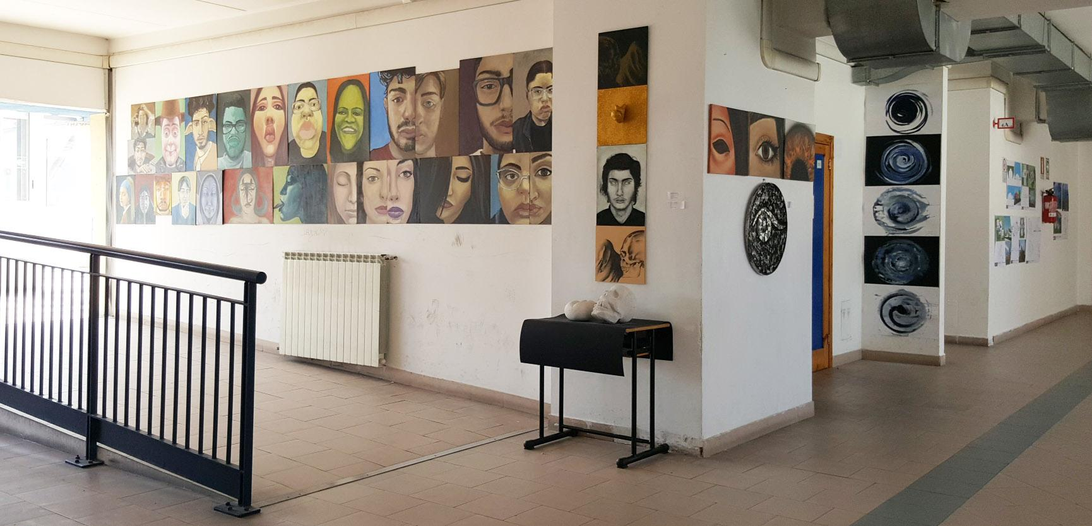
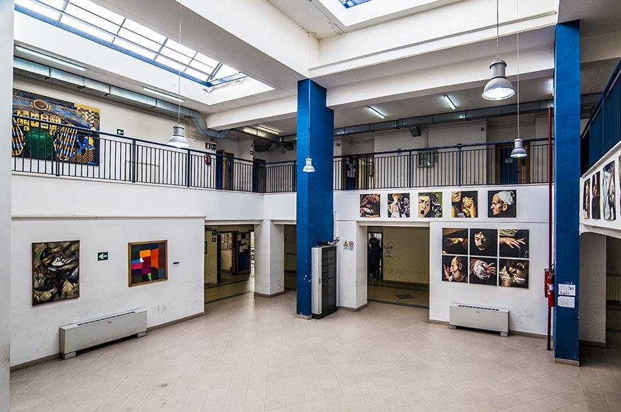
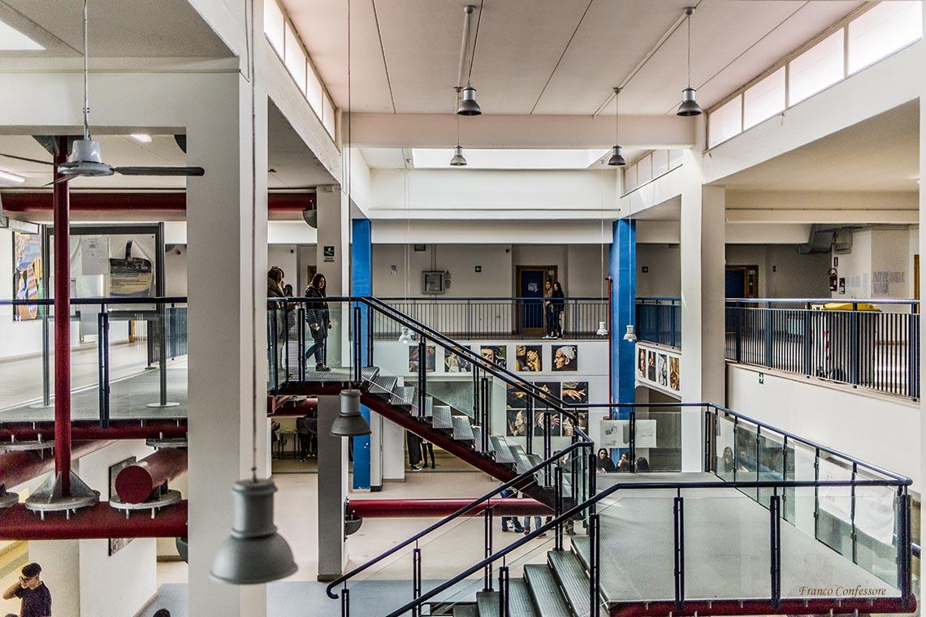
There are three academic courses:
arts
human sciences
languages

Slide 4
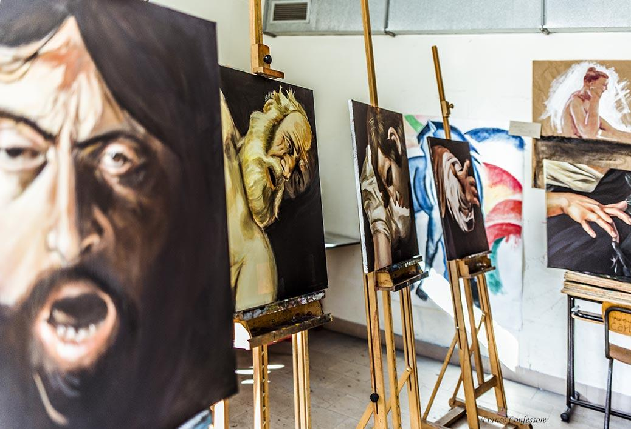
The arts course is divided into four sections:
Audiovision and Multimedia
Architecture and Environment
Graphics
Figurative Arts
The human sciences course is divided into two sections:
socioeconomic studies
socio-psychopedagogical studies
The languages course is divided into two sections, each of which is specialized in learning three foreign languages. The languages offered are :
English (compulsory)
German
Spanish
French

Slide 5
The school also provides students with two additive courses that are taught in the evening.
This gives the opportunity to adults who work, people who do not have the diploma or foreign students to learn the subjects of two of the academic courses: arts and human sciences
They will eventually have their diploma

Slide 6
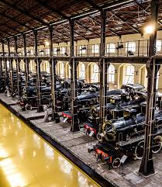
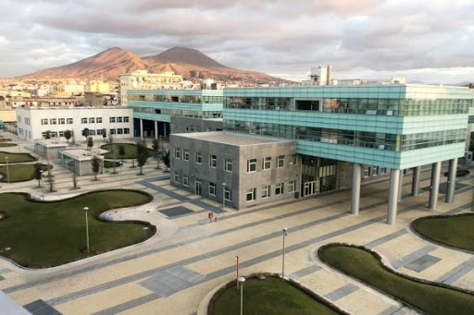
San Giovanni a Teduccio…
In the past the area was home to the most important Mediterranean
canning industry, Cirio and the first railway industry in Italy, serving
the Naples-Portici section of Pietrarsa. The factory ceased its activity
in 1975, but in the following years it was transformed into a railway
museum.
The municipality of Naples has also started a series of projects for the revaluation of the area such as the construction of buildings for the Federico II University.

Slide 7
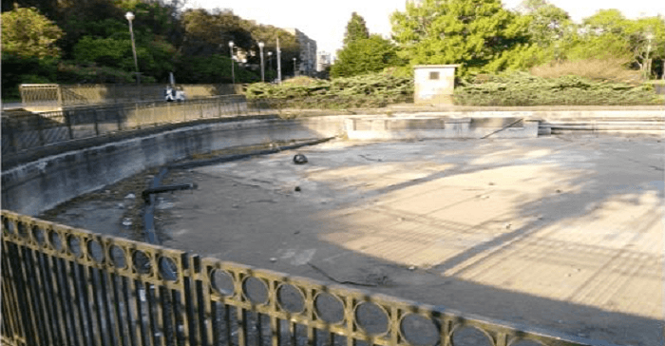
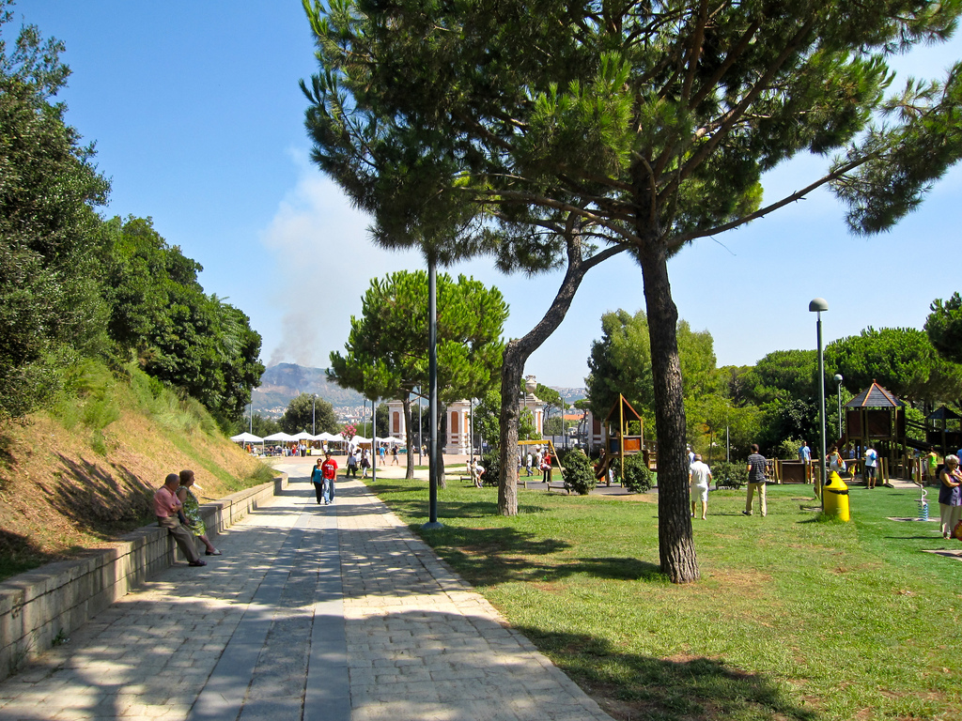
There are also some "to renew" areas such as the
Massimo Troisi park.
This park is an extensive green lung that is
excellent for physical activity and
recreation.

Slide 8
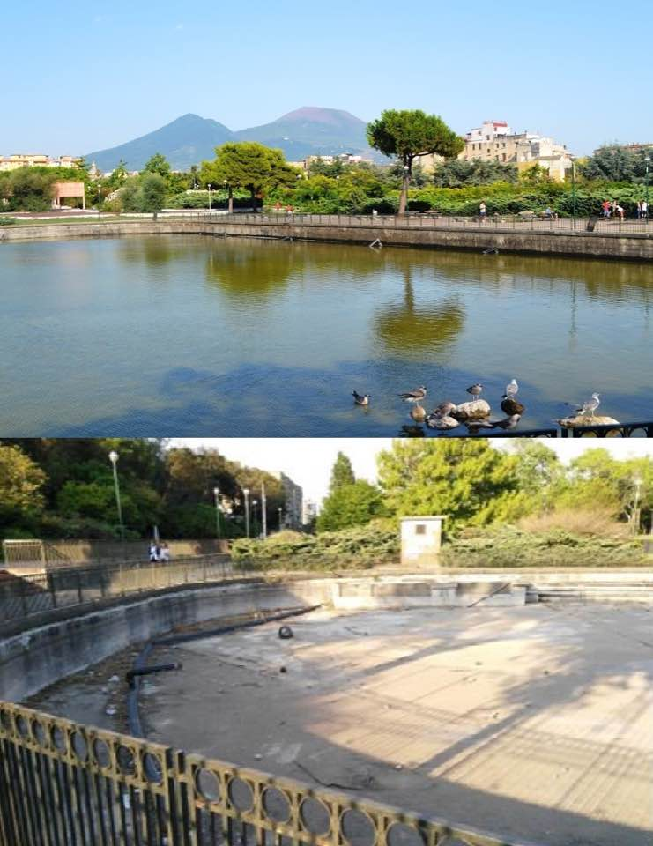
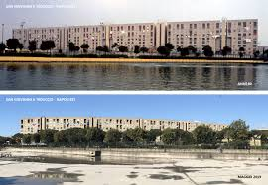
WHEN THE IMPOSSIBLE BECOMES POSSIBILE!
The artificial lake at the centre of the structure has been kept dry for some time due to maintenance issues. The presence of the caretakers is a guarantee for the dozens of people who day after day crowd the park.
There are some problems in the park, but "the impossible becomes possible". Our idea to revitalize the park would be to create events, in order to raise funds for daily maintenance, and so citizens could contribute in their own way by paying tickets to access the events. Initially, a fundraiser should be organized in the neighborhood with a generous donation from the shops in order to fix the park and create events. Earning money to fix the rides and refill the artificial lake, so that the old ‘Laghetto’ comes with us once again.

Slide 9
THANKS FOR YOUR ATTENTION!
Ambrosanio Martina
Maglione Cinzia
Maffei Antonella
Liquori Alessia
Santagata Aurora
Marigliano Chiara
Ambrosanio Claudia
Bastano Flavia
Piccolo Flavia
Maglione Marika
Del Monaco Conny
Cirella Anna
Cozzo Federica
Caputo Valeria
Anastasio Maria

