Slide 1
Teenage depression
And the policy our school runs.

Slide 2
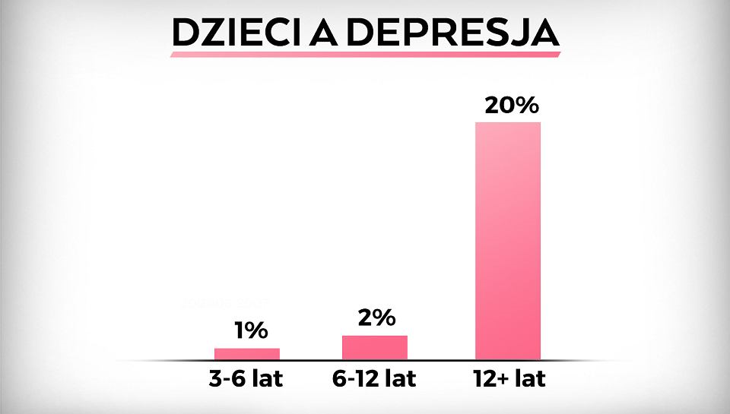
Teenage depression
Statistics are terrifying: in Poland at the age of 14, suicide ranks 14 place the causes of death and third place on people aged 15-18.
Children depression in Poland in 2018:
1%: 3-6 years old
2%: 6-12 years old
20%: 12 years old and more

Slide 3
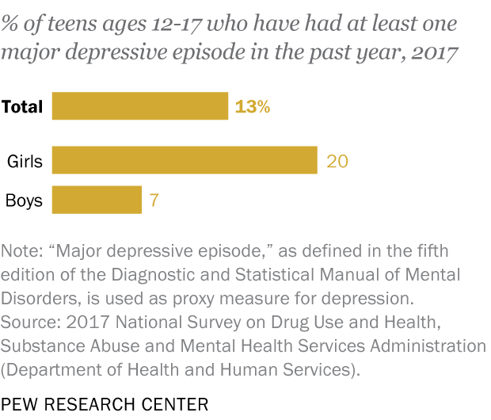
American teen girls three times as likely as boys to experience depression

Slide 4
Do we have got any specialists in our school?
We have got nurse and psychologist and they both work part-time.

Slide 5
School’s strategy for depression problem:
It depends on problem, because there are many solutions for each problem, but mostly:
Talk with class teacher
Contact with specialist out of school
Talk with pedagogue and psychologist

Slide 6
Our school works with:
Nongovernmental oragnisations
Universities of psychology (mainly for school personnel trainings)
Pernamently with Psychological and Didactic Counseling Center

Slide 7
What is done to prevent the problem in our school?
There is preventive and educational program for students.
Moreover, school makes trainings and presentations for students and teachers to teach them how to help other people or what to do when you feel depressed

Slide 8
Sources
www.poradnikzdrowie.pl/zdrowie/psychiatria/depresja-u-dzieci-i-nastolatkow
https://www.edziecko.pl/Junior/7,160035,23105569,coraz-wiecej-polskich-dzieci-ma-problemy-psychiczne-pomysl.html
https://www.pewresearch.org/fact-tank/2019/07/12/a-growing-number-of-american-teenagers-particularly-girls-are-facing-depression/

Slide 9
Thank you for your attention.
Milena Cieślak

