Slide 1
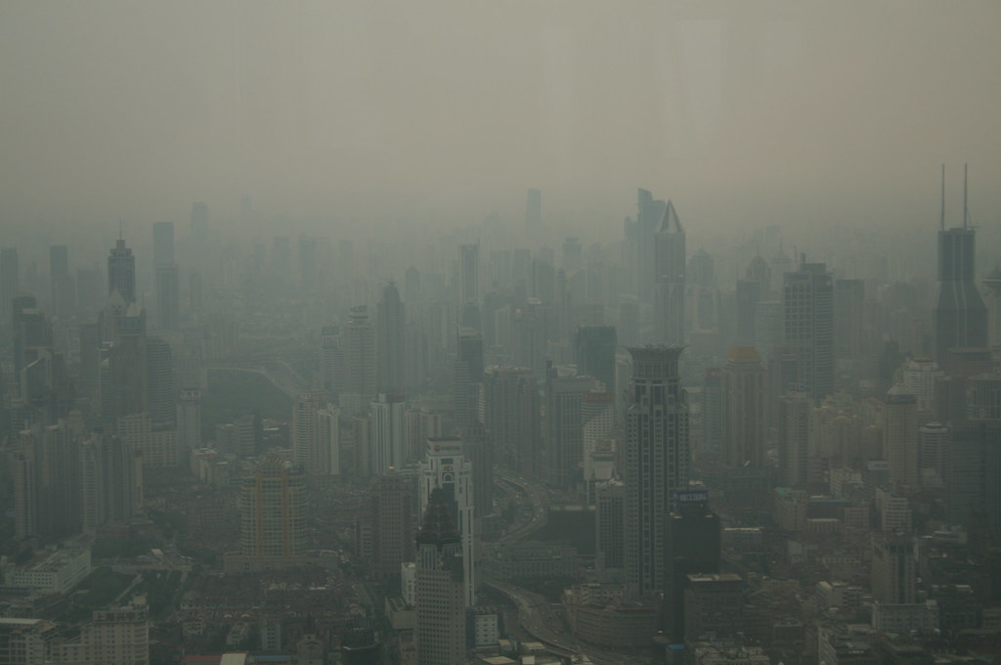
Smog – Solutions and causes
Flavia Bastano, Wiktoria Celejewska, Emma Blanes Ferri, Anna Wiczkowskla, Komninos Kostoglou, Maciej Sobieranski, Helene Jensen, Aleksandra Nowacka

Slide 2
Denmark
Causes:
Cars
Heating
Solutions:
Less tax on electic cars
Law
Good public transport
Money for sustainable solutions in households

Slide 3
Greece
Causes:
Too much traffic
Powerplants from nearby countries
Solutions:
restriction of the free flow of cars in particular crowded areas
Improvement on the public transport
Abolishment of nuclear power plants
Invenstment in renewables

Slide 4
Italy
Causes:
Domestic heating
Urban activity
Solutions:
Protocol ‘’Clean Air”
Cross-cutting measures
Smog eating cement/painting

Slide 5
Poland
Causes:
Heating houses with old stoves
Consumer products
Factories
Solutions:
Electric cars
Public transport
Solar energy
„CleanAir” project

Slide 6
Spain
Causes:
Traffic
Industrial gases
Solutions
Improvements to mobility
Environmentals taxes
Car restrictions in large cities

