Slide 1
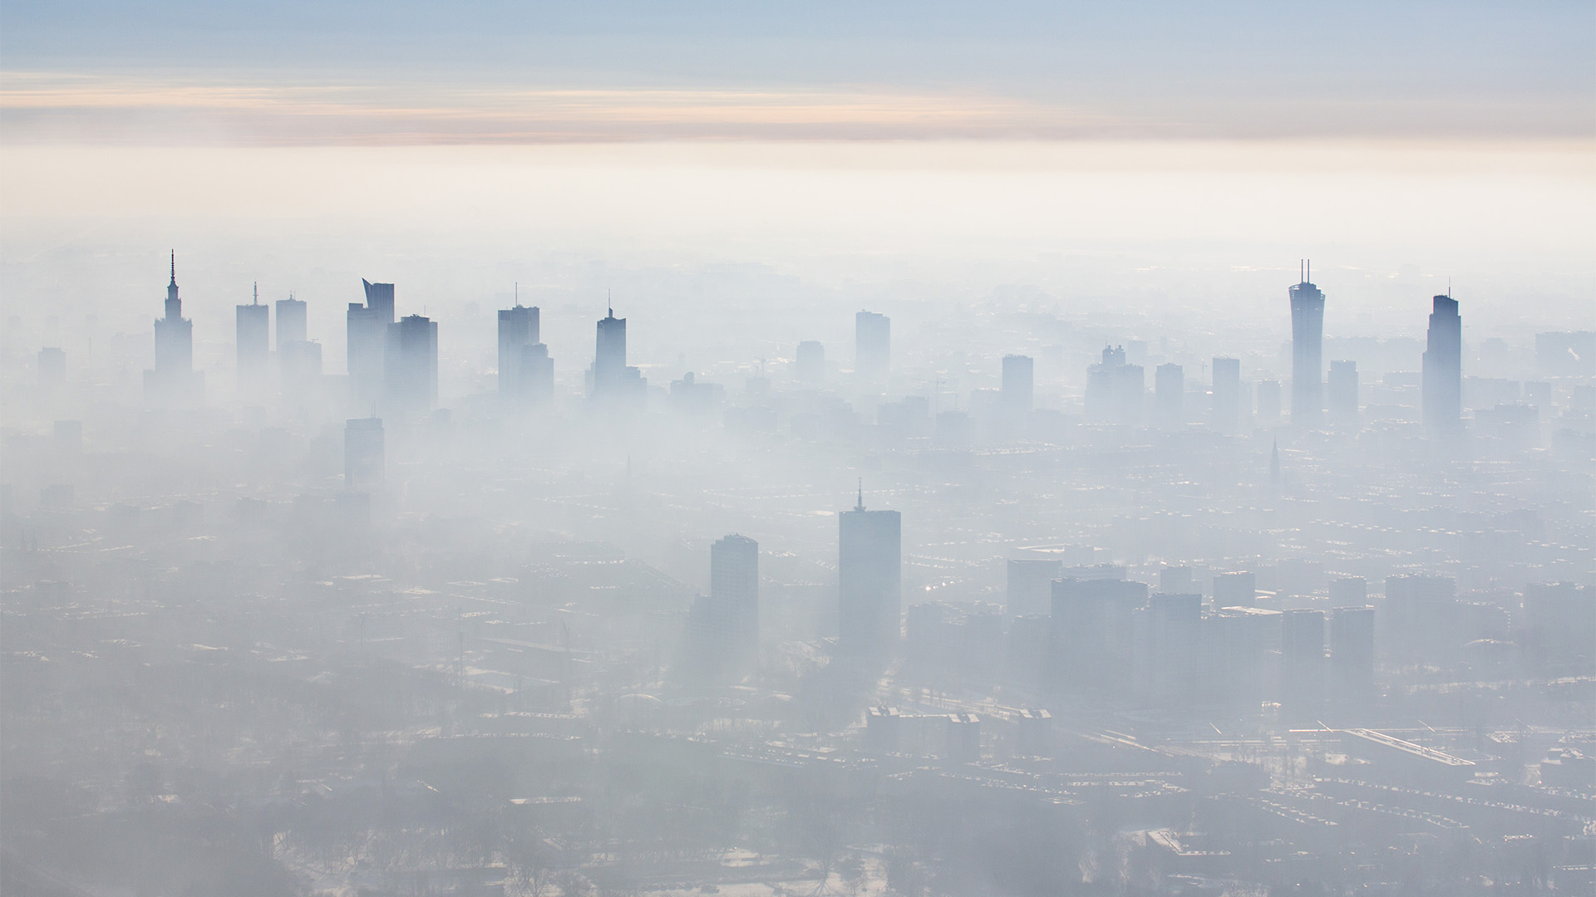
SMOG in different countries

Slide 2
Causes of SMOG in Denmark
Smog-forming sources
Geography affect the location and severity of smog.
Temperature and wind
Woodburning stove
What is done to prevent it?
These precautions can help protect you when ozone levels are high:
Limit your outside acivities
Keep your acivities gentler

Slide 3
Causes of SMOG in Greece
Traffic jams
Powerplants nearby
What is done to prevent it?
Retirement plan for old vehicles
Expansion of the subway system.
Restriction of the free flow of cars

Slide 4
Causes of SMOG in Italy
The causes are to be found in harmful emissions due to the use of coal as fuel.
Smog is also causes by cars emissions.
Major environment issues currently facing Italy include air pollution from energy and heating, transportation.
What is done to prevent it?
Making public transport more efficient, reliable and faster is a top priority because of the negligent use, and old vehicle usage should be lowered to lessen the very toxic emissions.
More sidewalks should also be integrated in the design of cities to further reduce the usage of vehicles.
Domestic heating is also a problem for its inefficiency in burning fossil fuels, so that is to be looked into.

Slide 5
Causes of SMOG in Poland
Heavy traffic
Too much sunshine
High or low temperatures
Factories
Consumer products.
Waste incineration
Heating houses
What is done to prevent it?
How big is the problem of smog in Poland?
Poland among the most polluted countries in the EU
Clean Air Programme
January 2017, the Polish government starting a 15-point anti-smog program
How Cracow prevents smog?
Krakow - strict rules regarding smoking in stoves. High subsidies to replace stoves.

Slide 6
Causes of SMOG in Spain
industrial gases that have got greenhouse effect
getting accumulated in our atmosphere.
Not using renewable energy
What is done to prevent it?
Changing the laws trying to stop the SMOG radiation and creation in big cities.
It is banned to drive any gas vehicle in the centre of the big cities, forcing people to go walking, on bicycle, by bus or on new electric vehicles for going in the city.
There are green points where people with electric vehicles can connect them to an energy source to recharge it.

