Slide 1
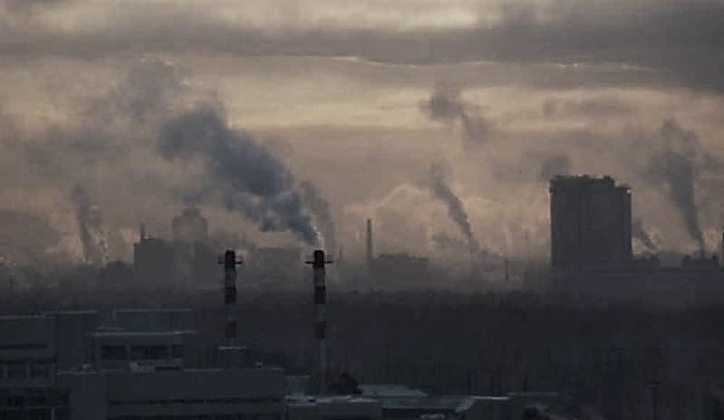
What is thepolicy of the Italian government towards smog and related environmental issues?
SMOG
.
.
What policy do other European countries run against?

Slide 2
Environmental issues of Italy
Major environment issues currently facing Italy include air pollution from energy and heating, transportation and industrial sources, polluted inland waters, acid rain, insufficient industrial waste treatment and disposal programs. The EEA (European Environment Agency) has estimated that more than 66000 people every year die prematurely due to particulare air pollution.

Slide 3
Environmental policies of Italy
Because Italy is a member of the European Union, its environmental policies largely fall under EU environmental legislation. With respect to air pollution and climate change, Italy is pushing initiatives designed to reduce black carbon emissions, particularly in the transportation sector. In the last two decades, Italy has decreased the emissions consistently. Italy will be looking to incorporate green initiatives into its economic policies.

Slide 4
Policies of other European countries
Some European countries have adopted the habit of traveling with bicycles to reduce smog, eliminate the most polluting vehicles, reduce the use of air conditioners to avoid global warming.

Slide 5
Every country should
All countries should give more weight to these problems.
All countries should react and find solutions as soon as possible.
Each of us should take note of what is happening to the Earth.

Slide 6
1. Redesign streets, squares and public spaces to create safety places for pedestrians and cyclists;
2. A mobility for zero emissions, not only on feet or with bikes, but also with electric traction;
3. Faster and more efficient busses;
4. Thousands of trains, metropolitans, trams and thousands of electric or bio buses for public transport in urban areas;
5. Reducing the use of diesel vehicles in city;
7. Only make one of three movements with vehicles, if not necessary;
8. Reduce the use of air conditioners and start to use fans and ceiling fans.

