Slide 1
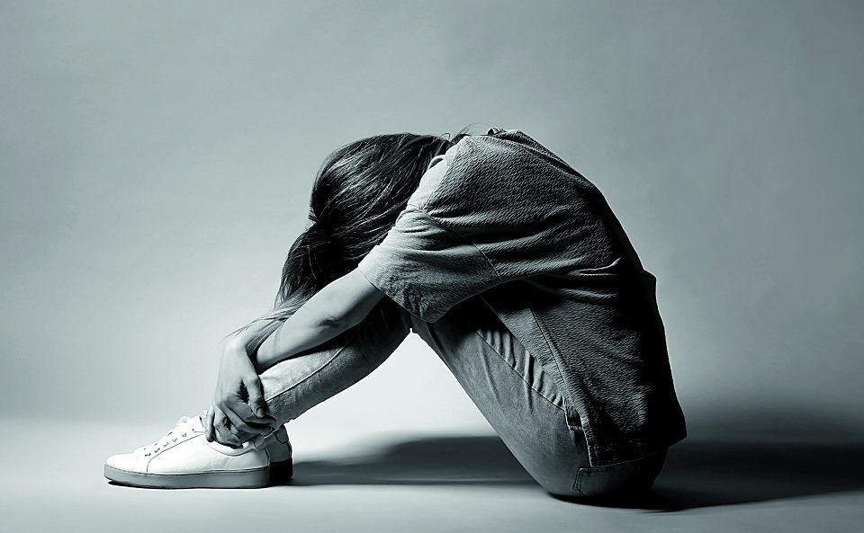
TEENAGE DEPRESSION IN POLAND

Slide 2
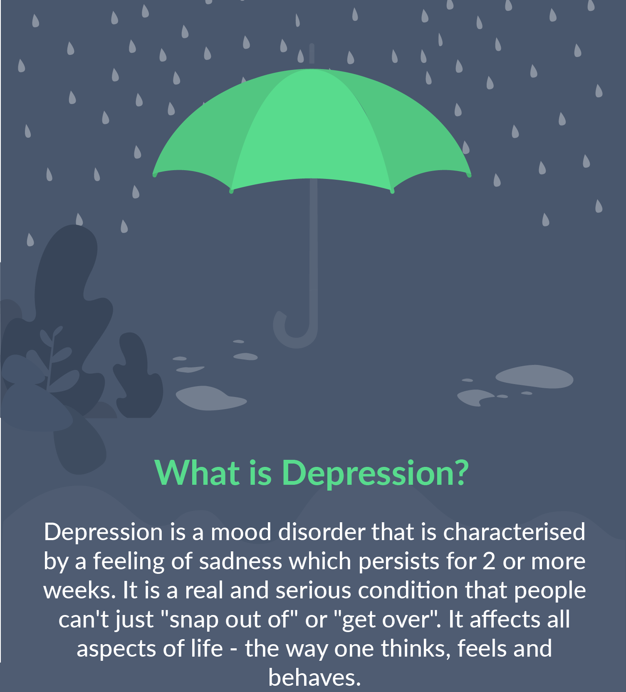
Is teenage depression a serious problem in Poland?
In Poland, research results show that about 20% of adolescents suffer from depressive disorders
depressive symptoms can be seen even in every third teenager

Slide 3
who can we get help from at our school?
-psychologist
-pedagogue
-nurse
-form teacher

Slide 4
Institutions which our school cooperates with
- Specialist Psychological and Pedagogical Clinic
-Municipal Social Welfare Centre
- County Family Support Centre
- Family Court
- Municipal Guard and County Police Headquarters
- State Fire Service
- District Sanitary and Epidemiological Station
- Health Care Facility
- County Labour Office
- Grojec Centre of Culture

Slide 5
School strategy, when a psychological problem is recognised
- regular assistance from the school psychologist and psychological-educational counselling centre
- contact with parents
- adapting the requirements of teaching and the way it is taught

Slide 6
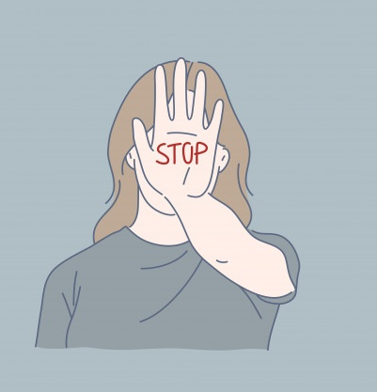
What is done to prevent this problem?
teacher training
training for psychologists and educators
at the request of the form teacher or the management, special workshops can be held for the class with the participation of a psychologist
Workshops for students conducted by the psychological and pedagogical clinic

Slide 7
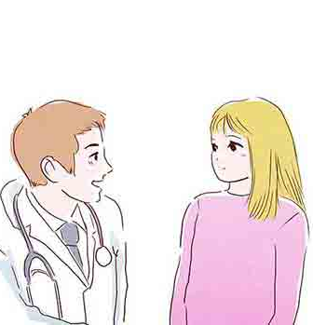
Improvement or deterioration?
"There are more students with special judgements, including those stating depression, but the percentage of depression among the disorders in these judgements has not increased noticeably over the years that I have worked here".
-A part of interview with our school psychologist

