Slide 1
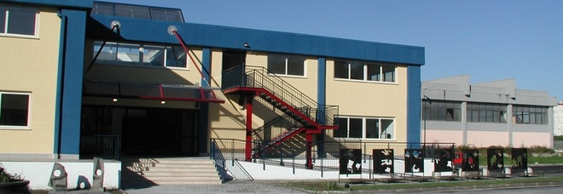
Our school

Slide 2
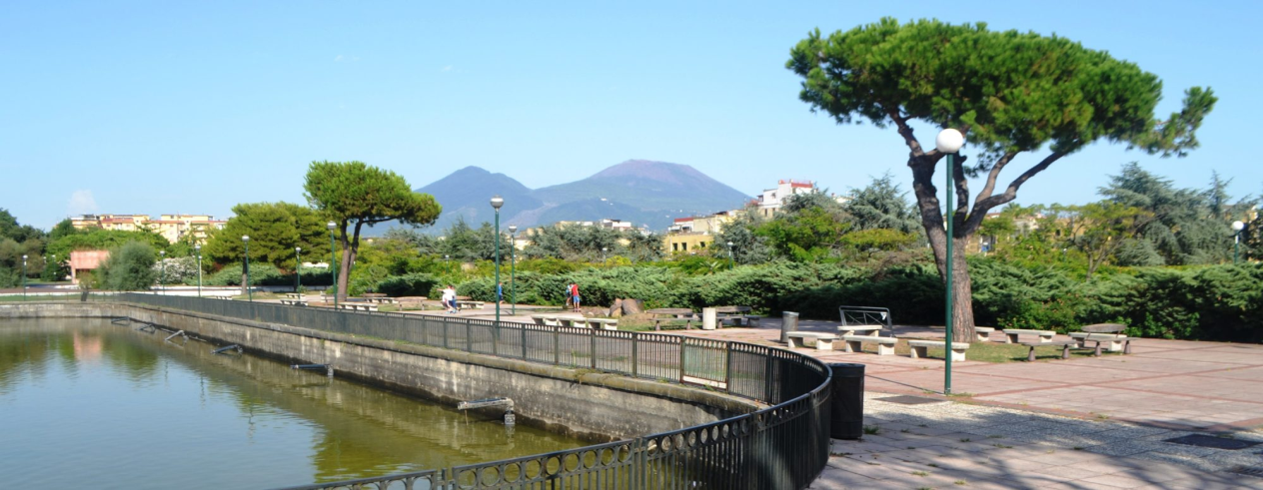
Our school is called “Liceo Don Lorenzo Milani”. It is situated in the Eastern part of Naples, more exactly in San Giovanni, on the road “Viale 2 giugno”. in front of the school there is the park “massimo troisi”, but we are used to call it “laghetto”.

Slide 3
Here students can choose between Human Science, Social Economic, Languages and Artistic studies.

Slide 4
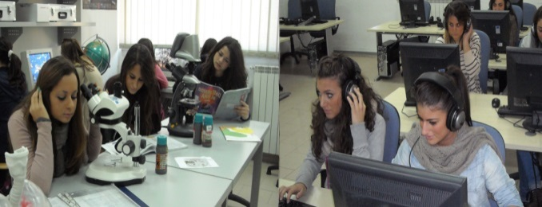
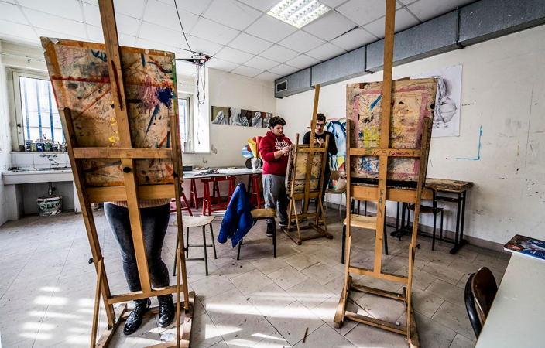
There are many laboratories; 2 computer labs, a linguistic one, art laboratories ( architecting, multimedia, drawing and photography ) and a science lab. We also have got a library and there is an auditorium.

Slide 5
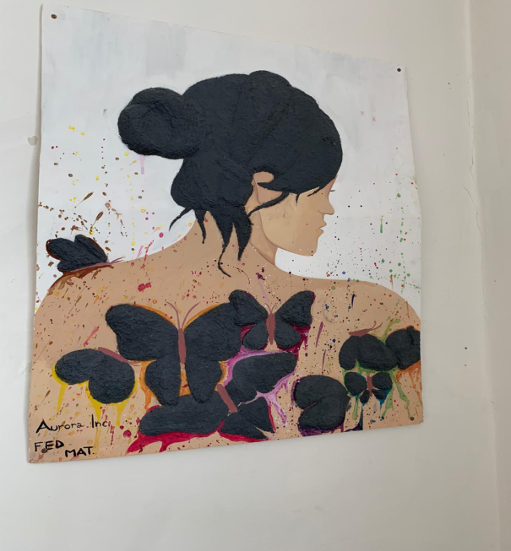
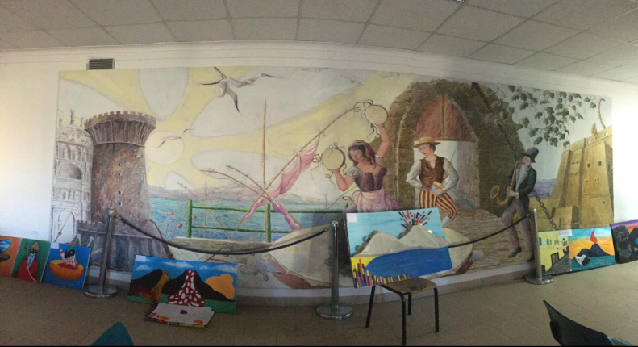
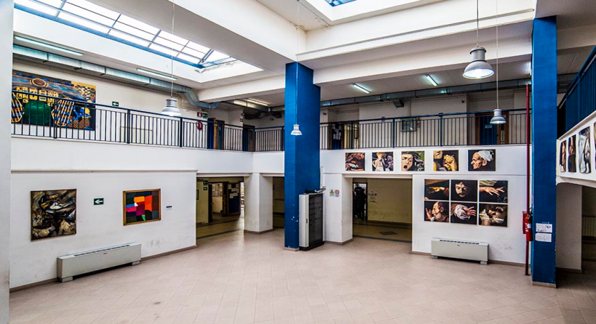
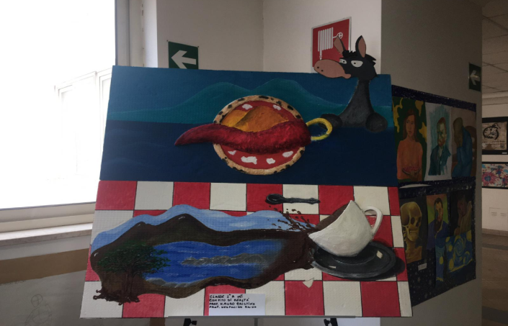
Walking through our school on its walls you can notice a lot of pictures, realised by the students of the artistic studies.

Slide 6
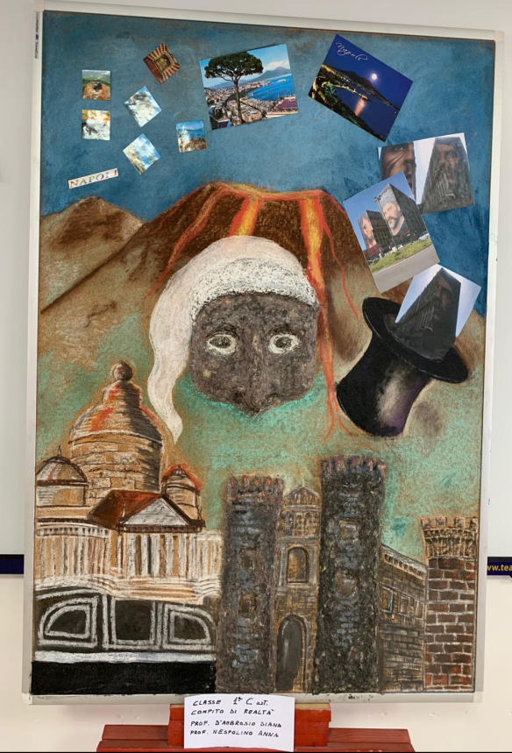
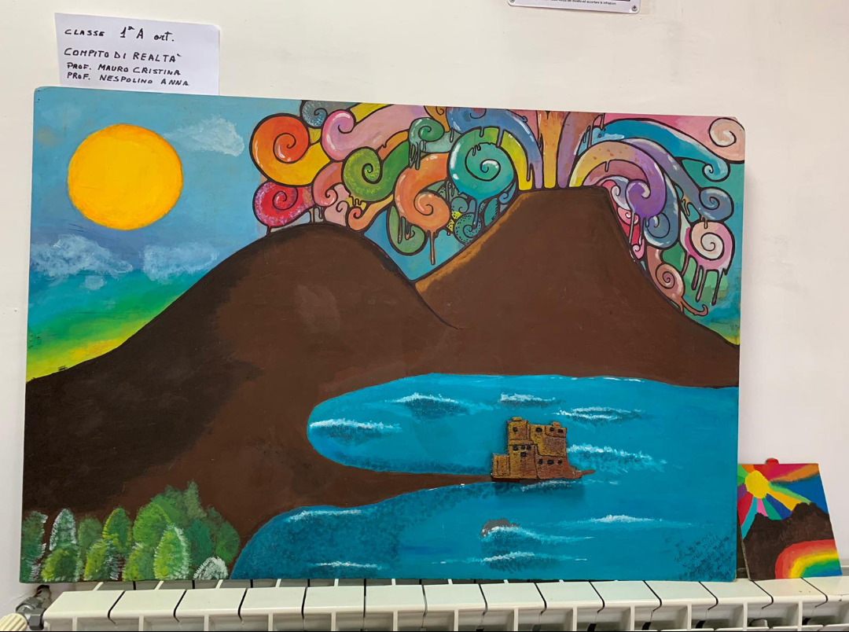

Slide 7
We hope you enjoyed our school! See you in 2021!

