Slide 1
USE AND MISUSE OF TECHNOLOGY
“IMPOSSIBLE BECOMES POSSIBLE: YOUNG ENTREPRENEURS IN ACTION”

Slide 2
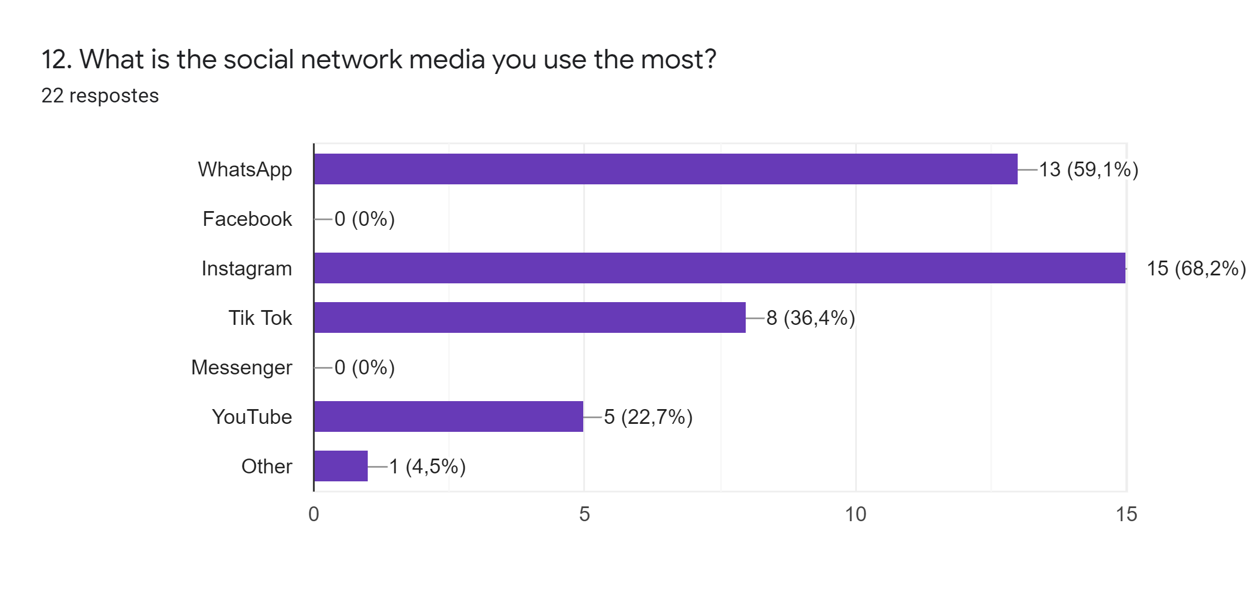

Slide 3
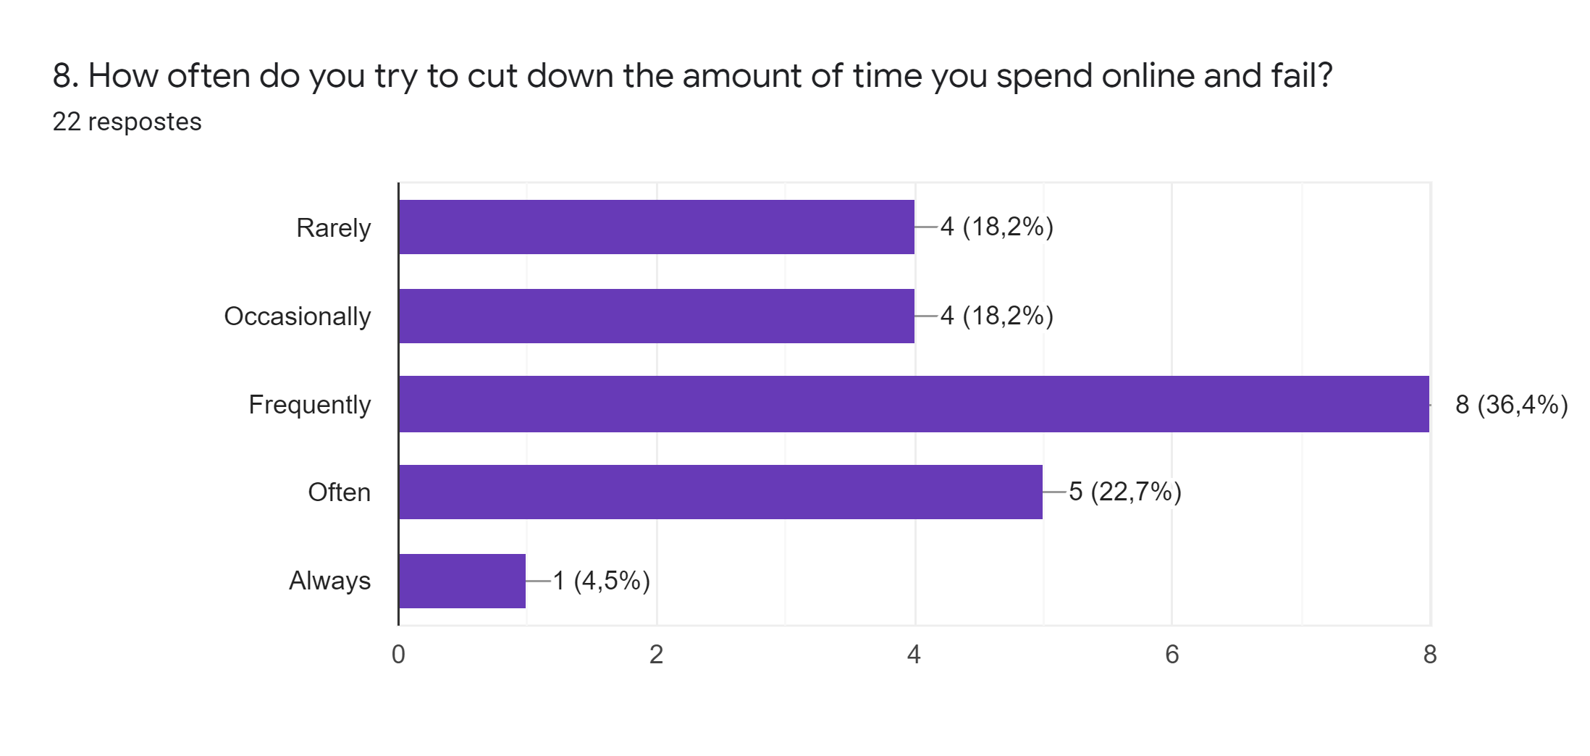

Slide 4
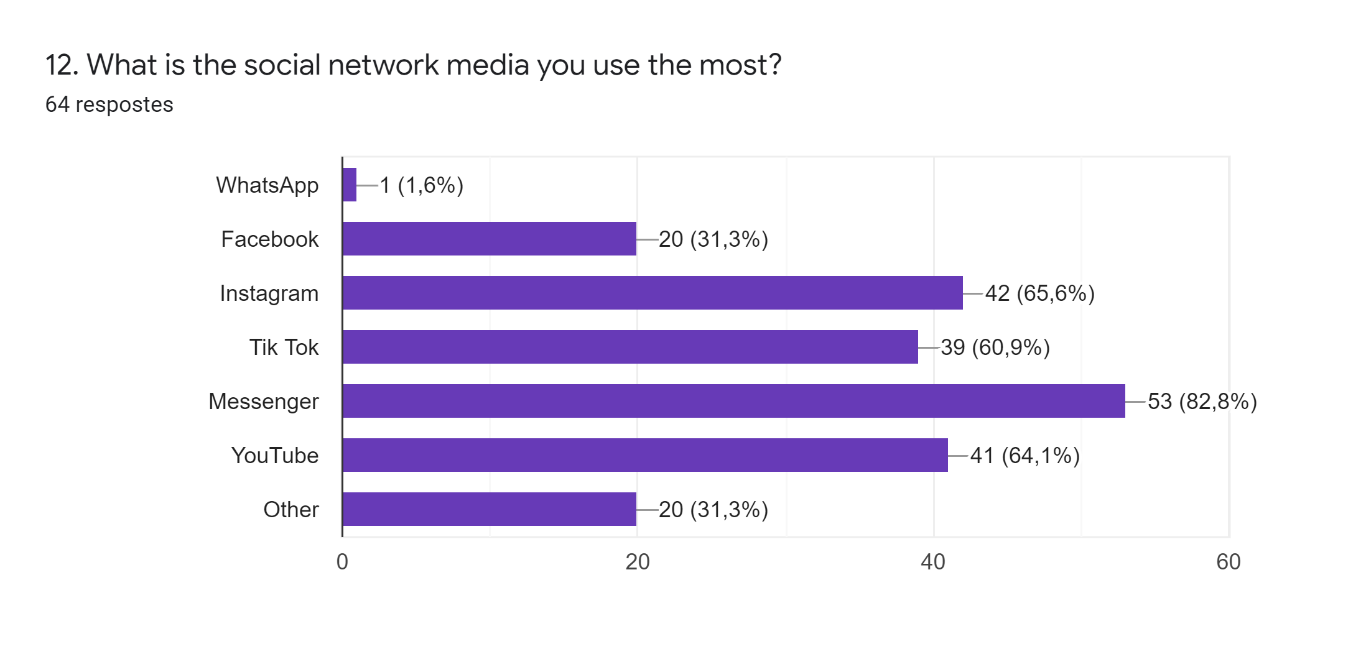

Slide 5
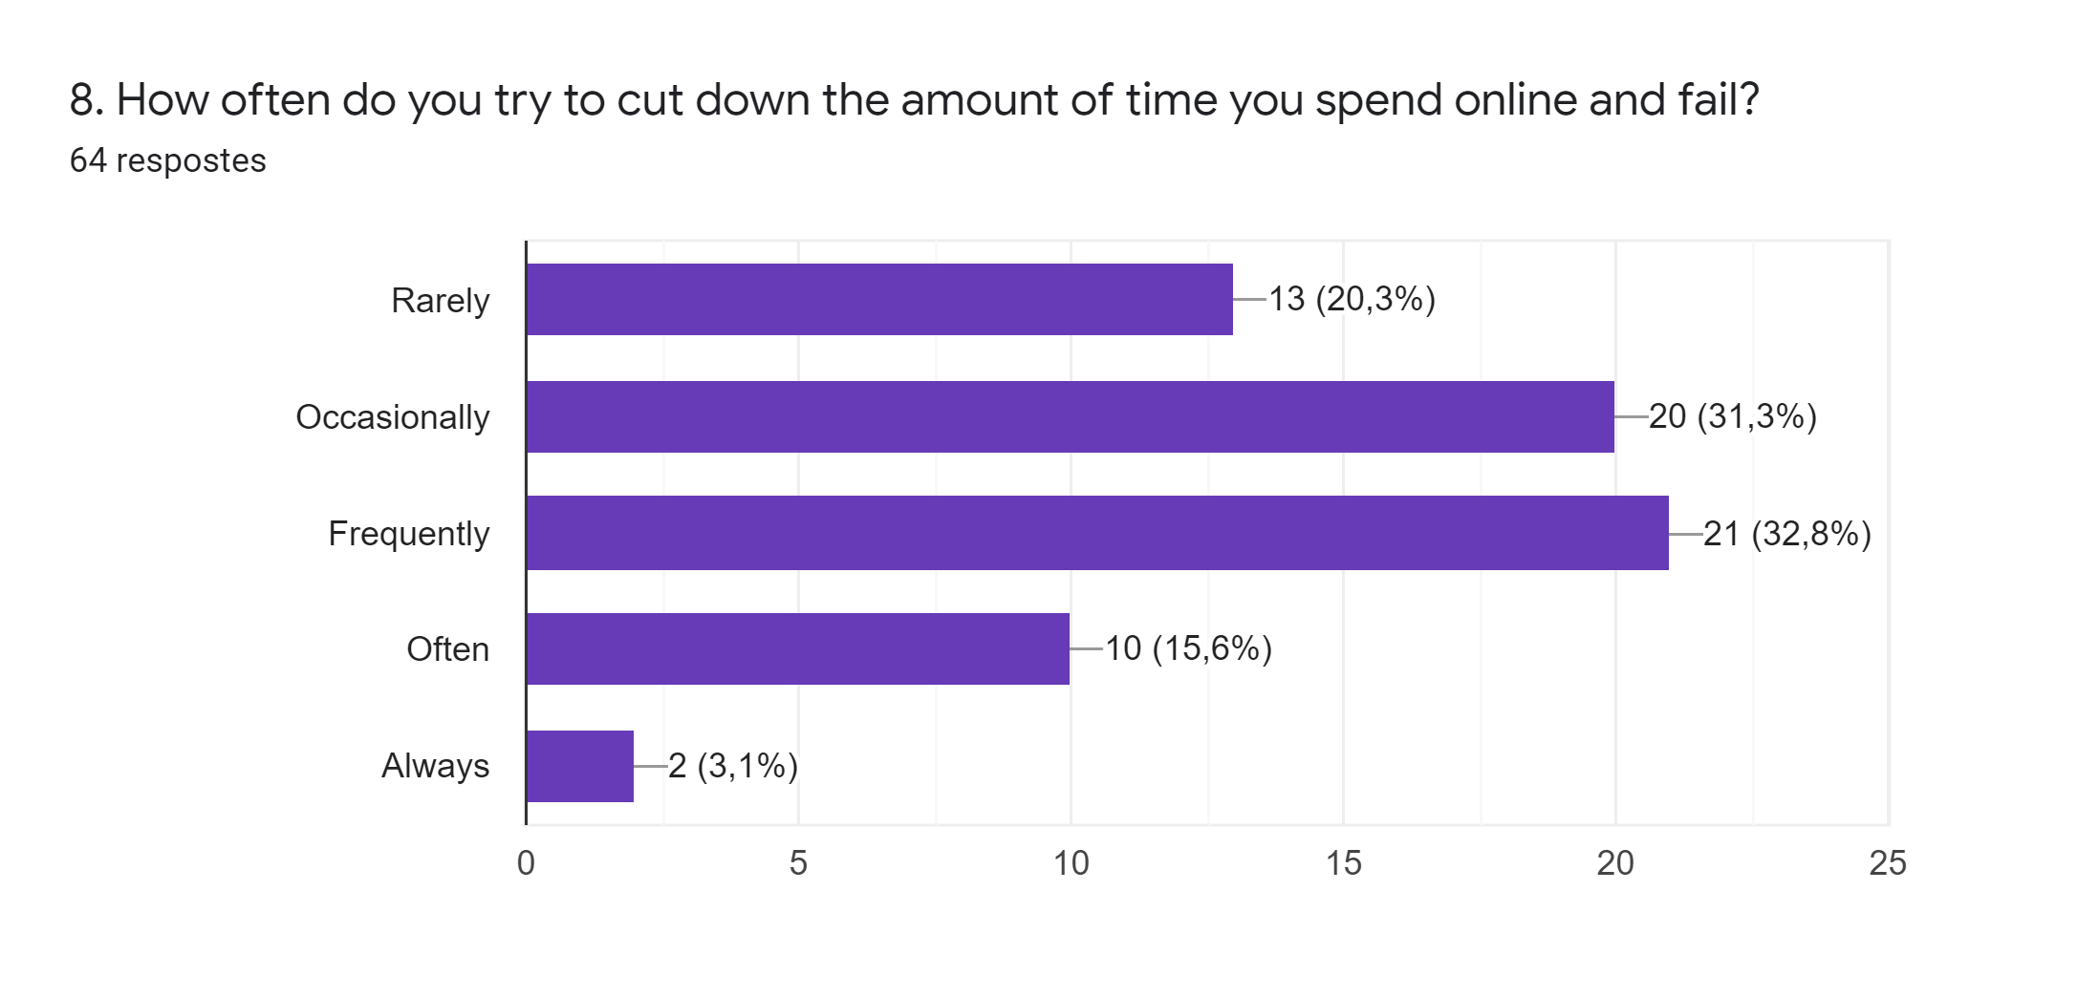

Slide 6
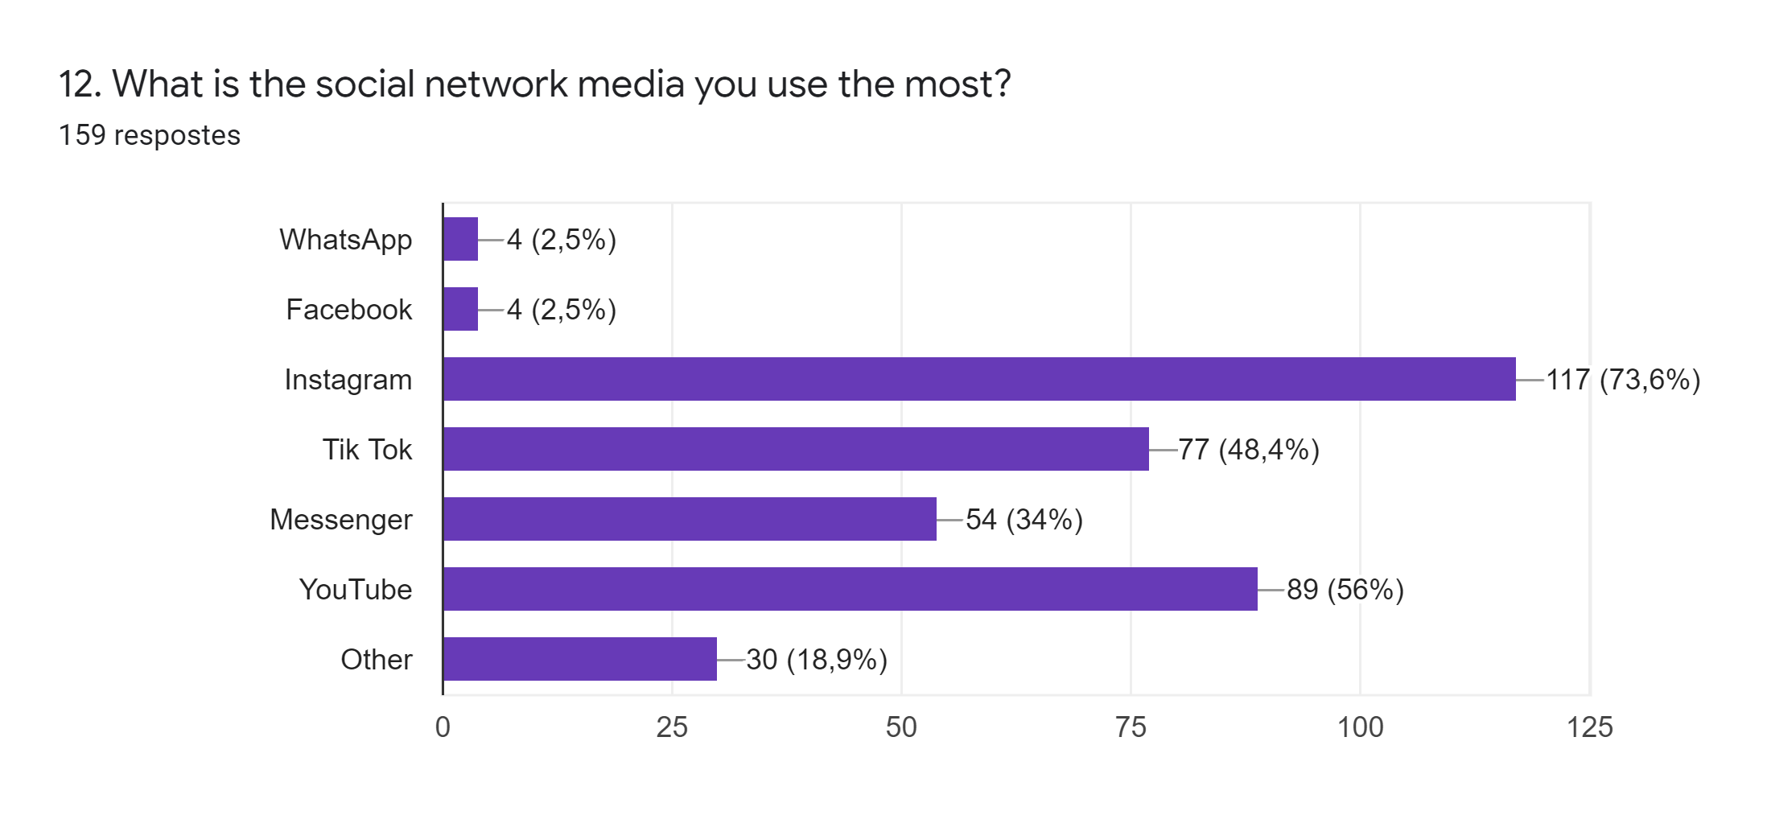

Slide 7
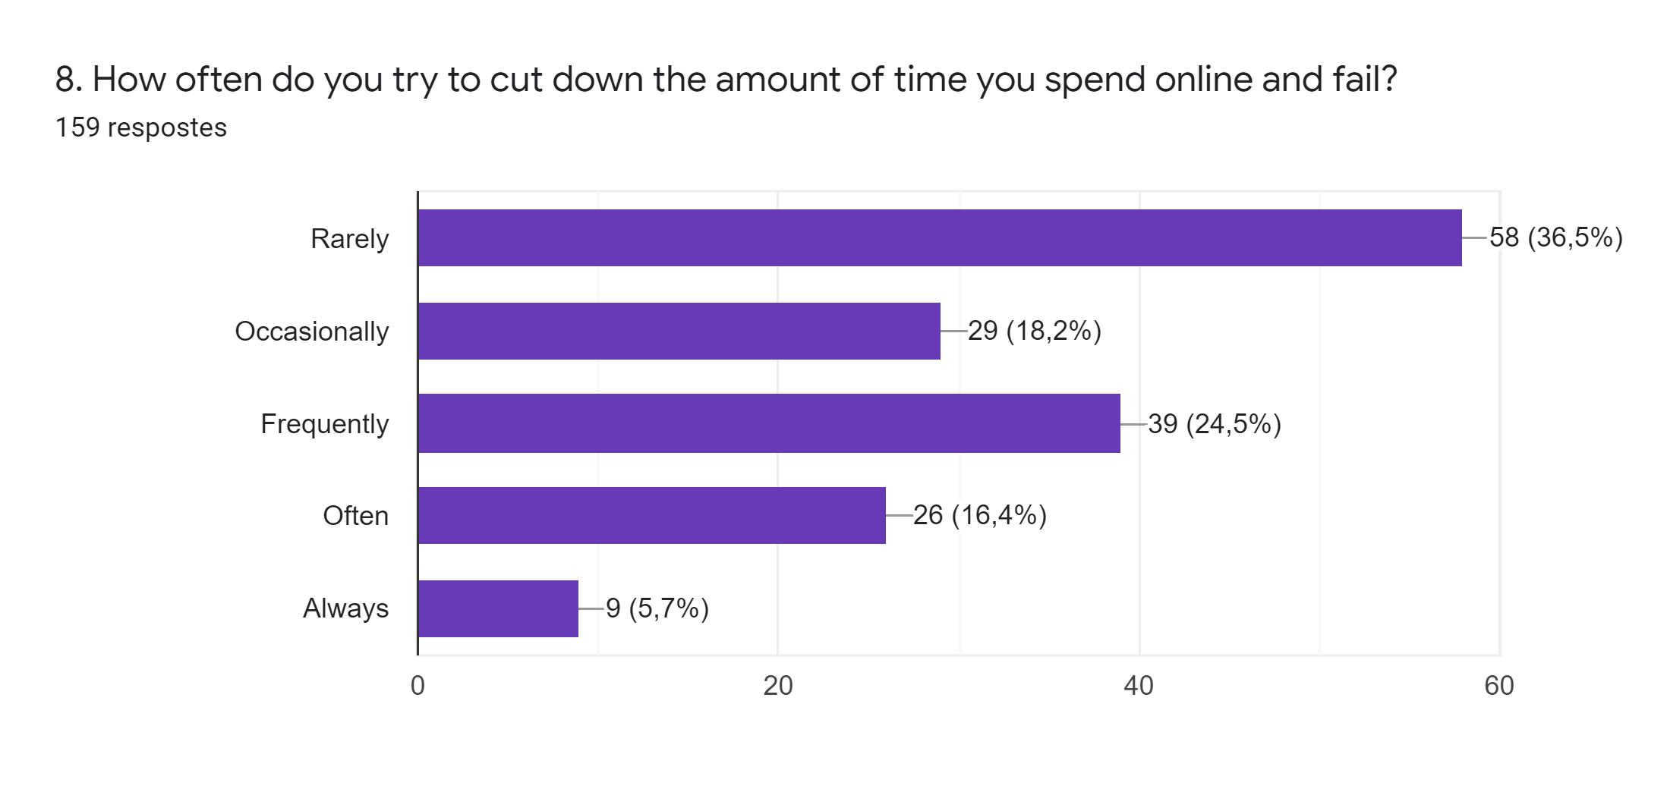

Slide 8
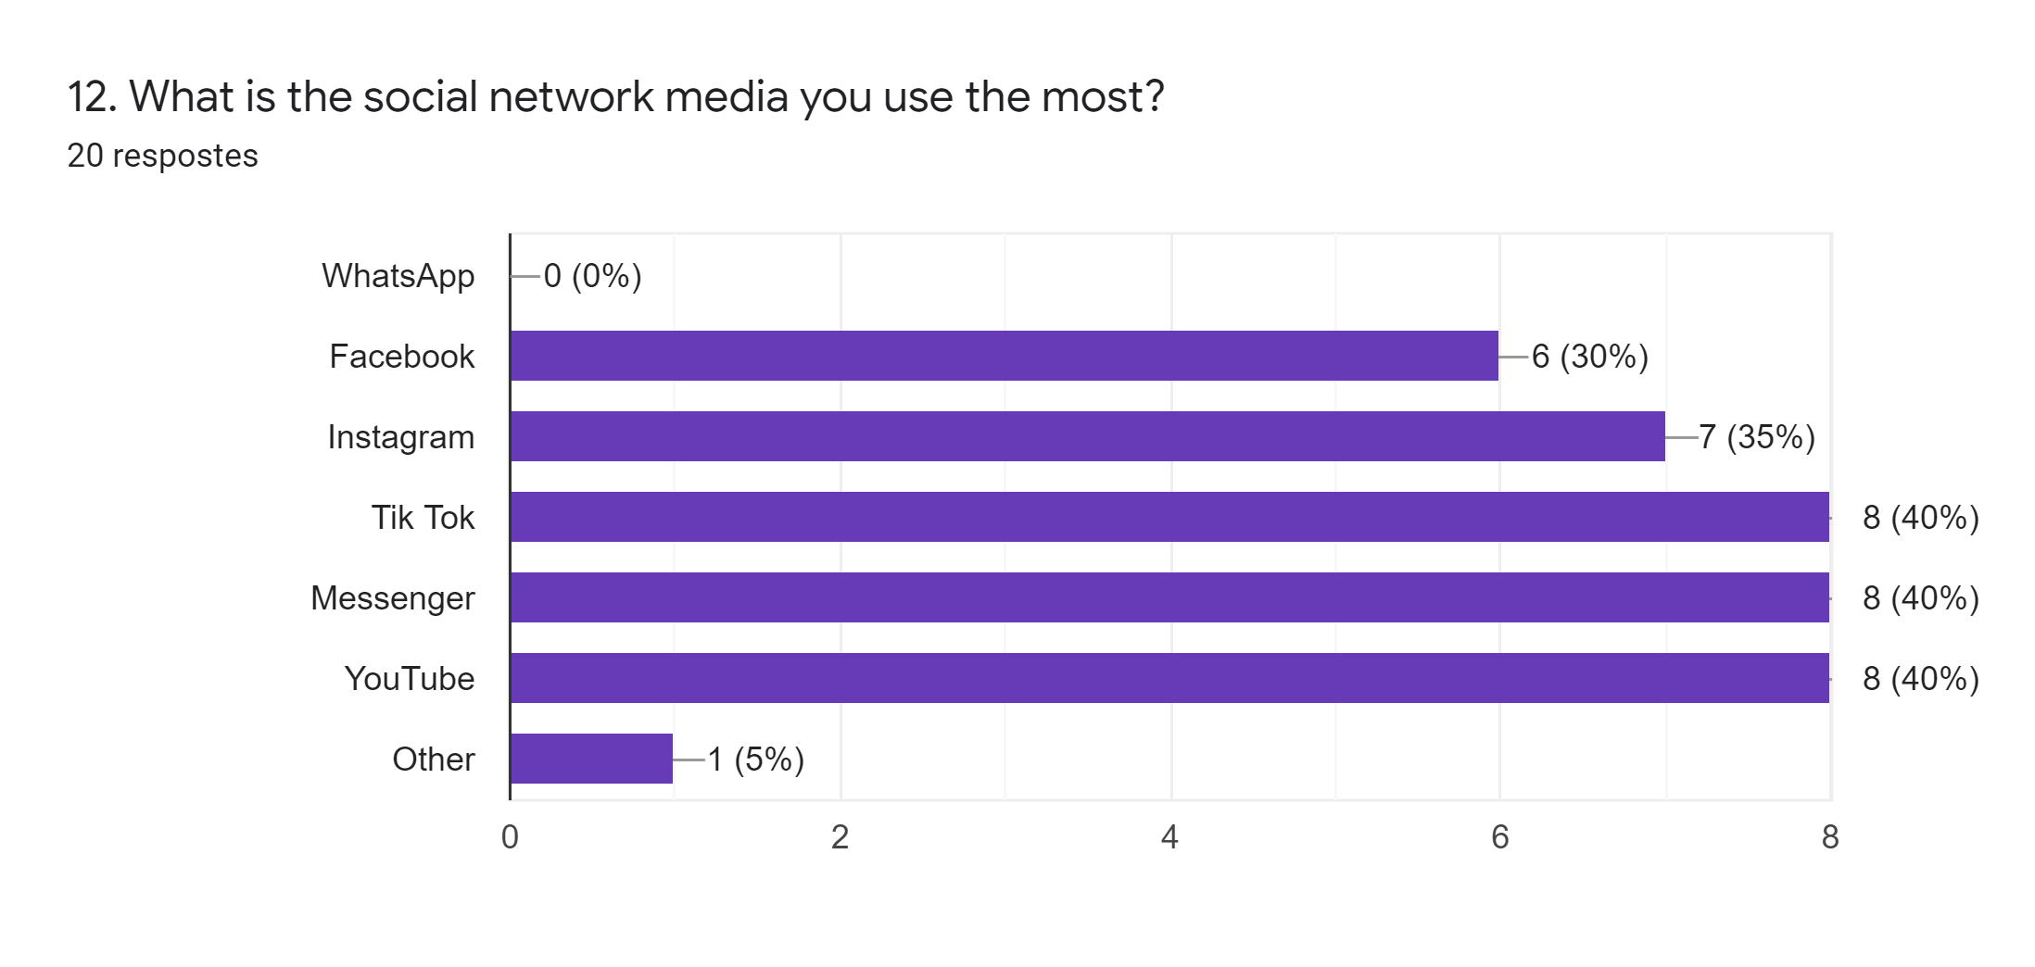

Slide 9
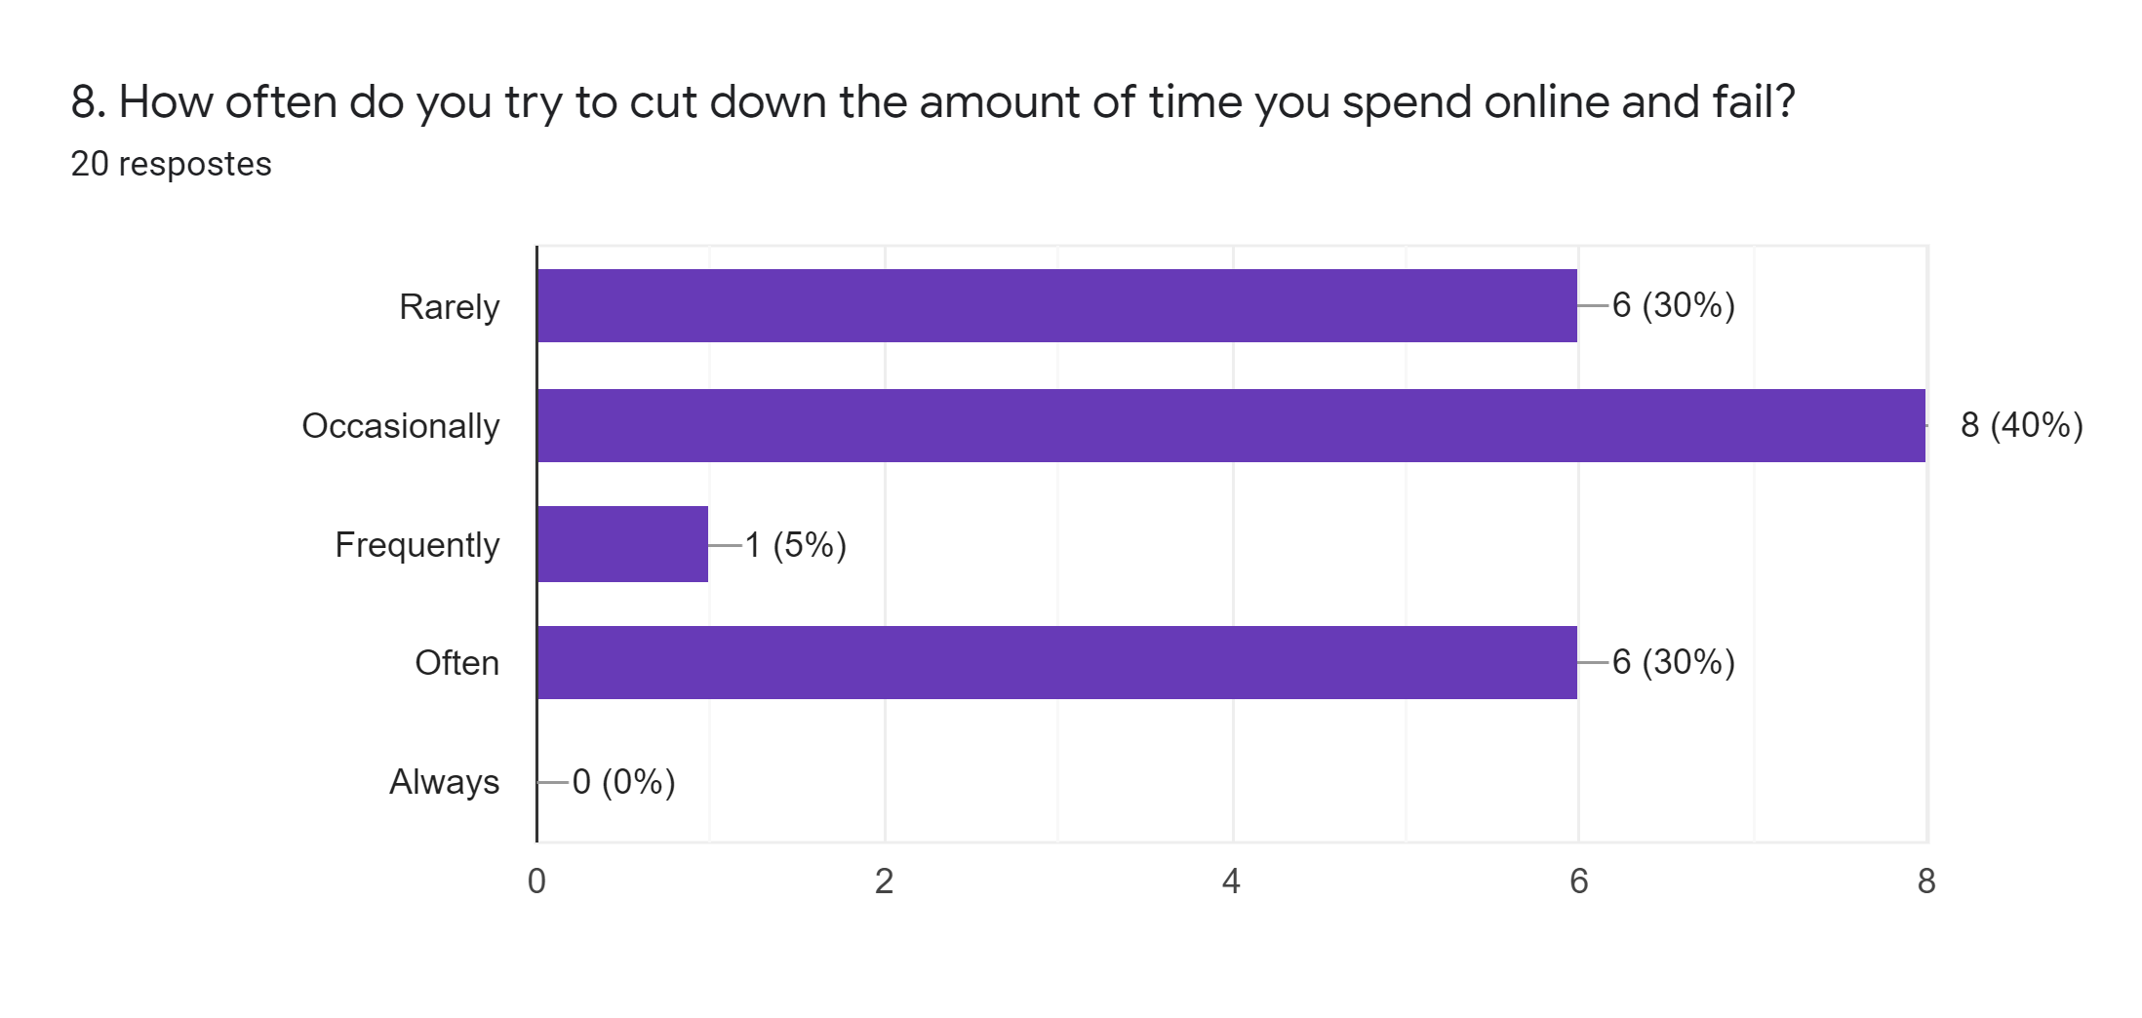

Slide 10
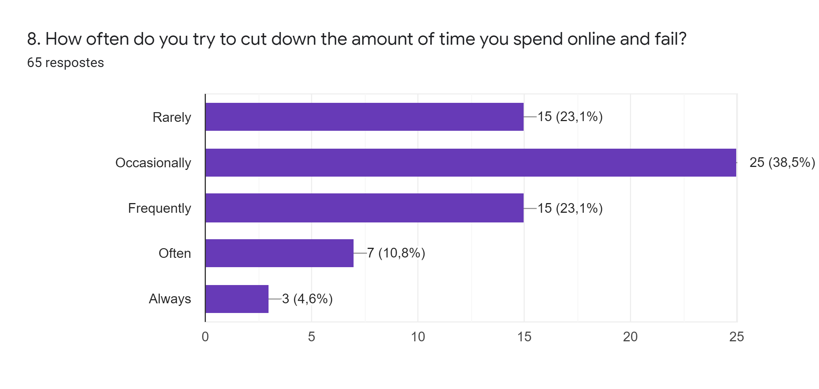

Slide 11
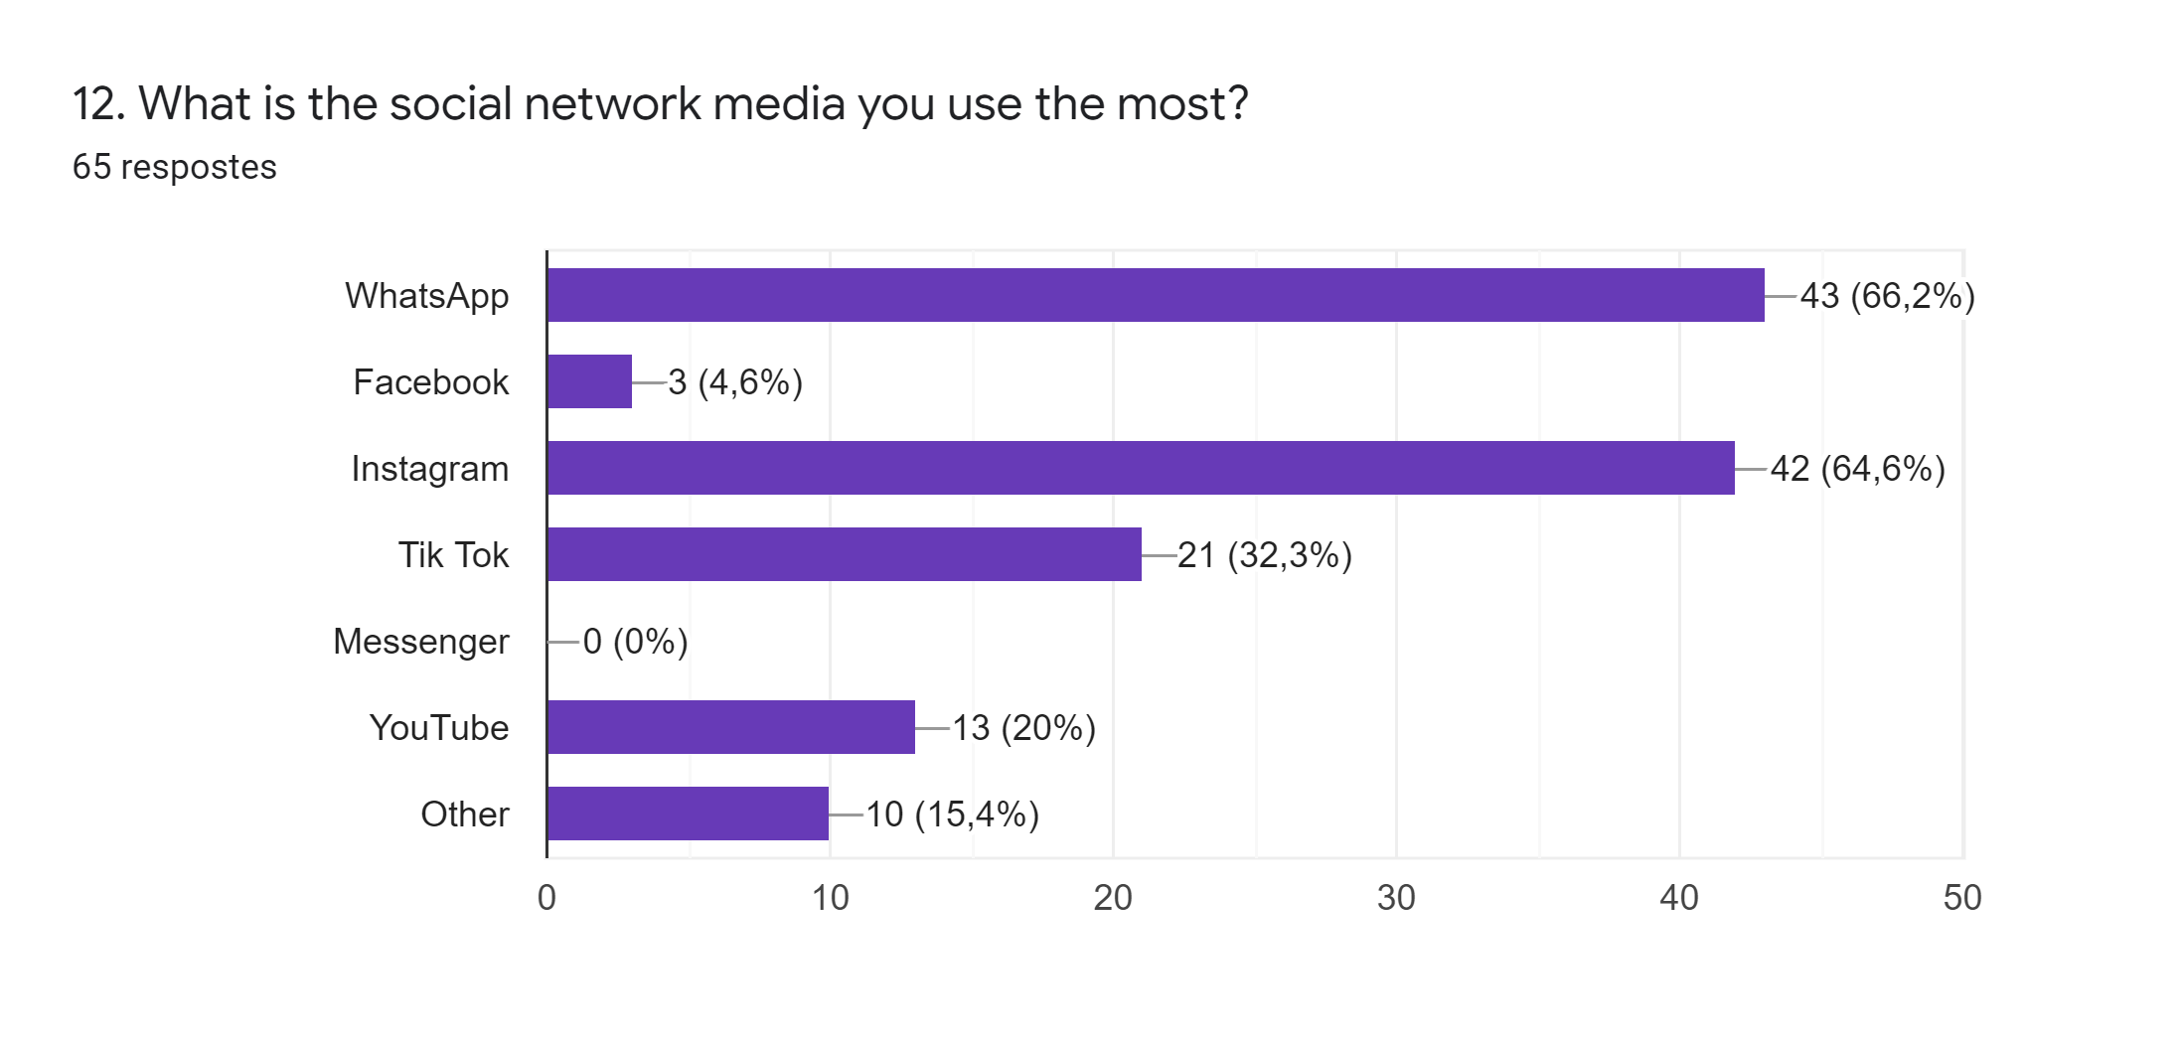

Slide 12
Do you have any friends who are addicted to social networks or technology? Do you think their personality has changed?

Slide 13
Do you depend on technology/social networks to study and meet your friends?

Slide 14
How do you feel after a day without using any kind of technology?

