Slide 1
Politicians in a fight againts SMOG
Presentations made by Adrianna Bukowska 1c1

Slide 2
Table of contents
Polish government- Politycy towards Smog
EUROPE RUN AGAINST SMOG
After pressing the arrow you will go to the topik chosen by you.

Slide 3
Polish government- Policy towards Smog
The Polish goverment took smog very seriously, especially in a big cities like Warsaw and industrial districts e.g. Katowice. Politicians started program called Clean Air. The main objectives of program are to improve the Energy efficiency of single-family houses and reduce dust emissions to the atmosphere. This is to be achieved through thermomodernization of houses and replacement of furnaces. Polish government decided to introduce punishments for rubbish smokers in furnaces.

Slide 4
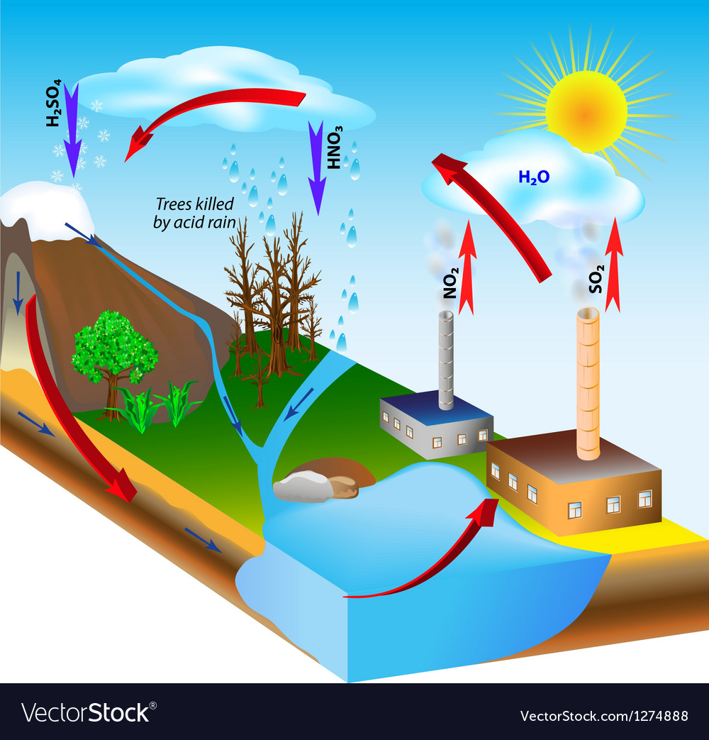
There is also acid rain in Poland which results in damaged forests (trees without needles). The above-mentioned activities have a reference to prevention of acid rain. They prevent tchem by replacing stoves, encouraging people to ride bicycles and electric scooters than cars and using chimney filtres. Acid rain can cause water acidification. The result is that its pH is similar to that of citric acid.

Slide 5
Europe run against smog
The European Union is very supportive of its member states in the fight against smog. The EU supports tchem through subsidies in furnace replacements etc. As in Poland, in other European countries, more and more people in big cities give up driving car for cycling. In many European cities, people were fascinated by electric scooters. They are not only a fast means of transport but also not damaging the environment.

Slide 6
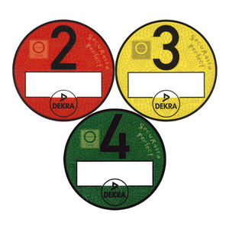
In France special car stickers are applied to determine how much their polluted the air. Stickers Begin with pollution 0 - green (electric motors), through pollution level 1- purple, 2 - yellow, 3- orange, 4 – brown, to level 5 indicating very high pollution – gray. Cars with high pollution are not allowed to enter the capital of France – Paris. The same law also applies in Germany and the UK. In the capitals of European countries the entry of trucks has been restricted ti reduce exhaust emission. In Dublin , a total ban on the sale of hard coal was introduced in 1990. As a result, smog air pollution has been reduced by 70%.

