Slide 1
The problem of teenage depression

Slide 2
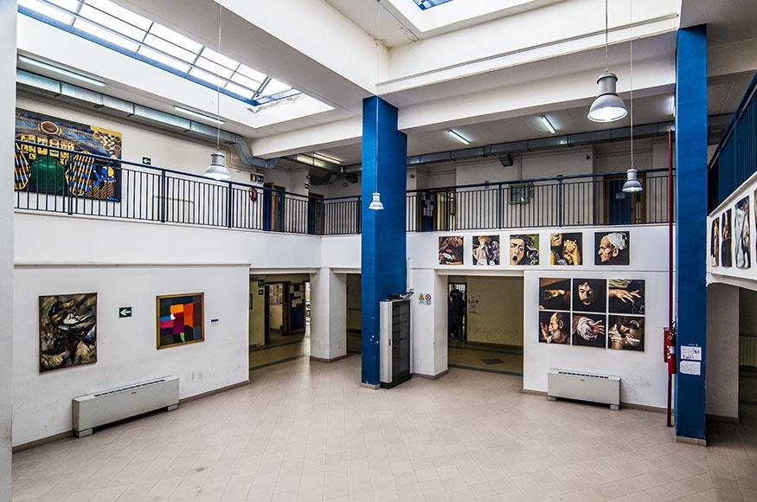
How does our school deal with the problem of teenage depression?
Psychological School Desk
It includes a series of individual paths to:
reduce moods that cause malaise
to discuss students' study and work path choices
Don Lorenzo Milani high school

Slide 3
the exclusion of a student from the class group
non-attendance at lessons
voluntary isolation from school activities
What are the steps taken when a psychological problem is recognized?
The teachers report the anomalies, for example:
aggressive attitude towards teachers and classmates
bullying

Slide 4
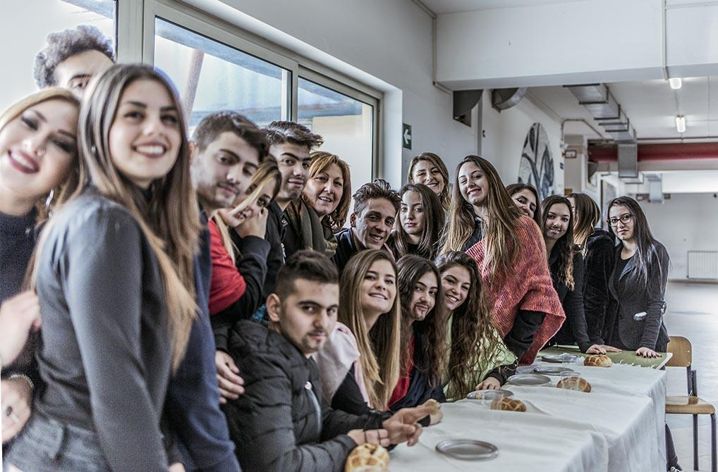
What to do?
contact the families or request a meeting with the student
involvement in the activities that the school organizes.

Slide 5
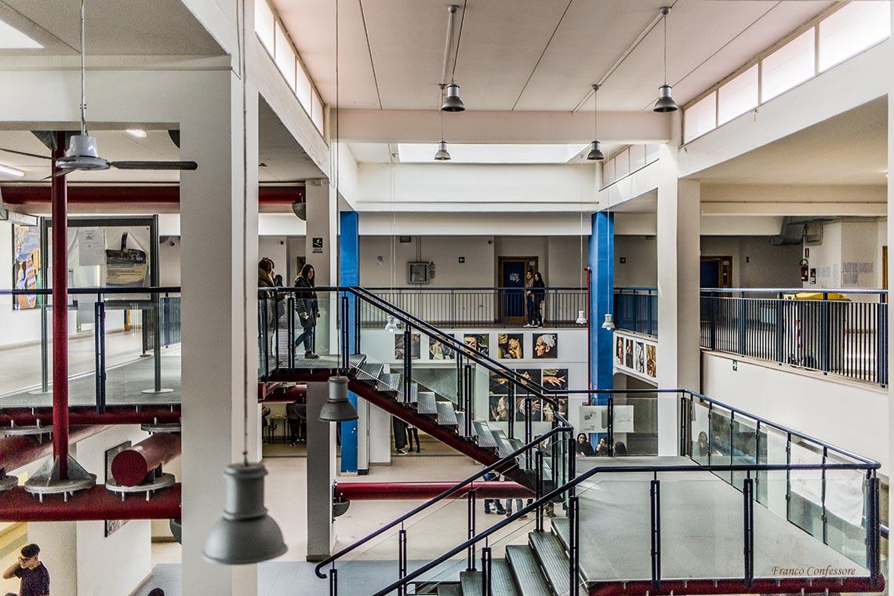
How common is the problem of teenage depression in our school?
From the surveys conducted annually, it appears that the rate of depression among the students of Don Lorenzo Milani high school is very low.

Slide 6
What is done to prevent this problem?
The school organizes:
-voluntary activities, collaboration with the OASI association
-foreign language enhancement activities
-FAI activities

Slide 7
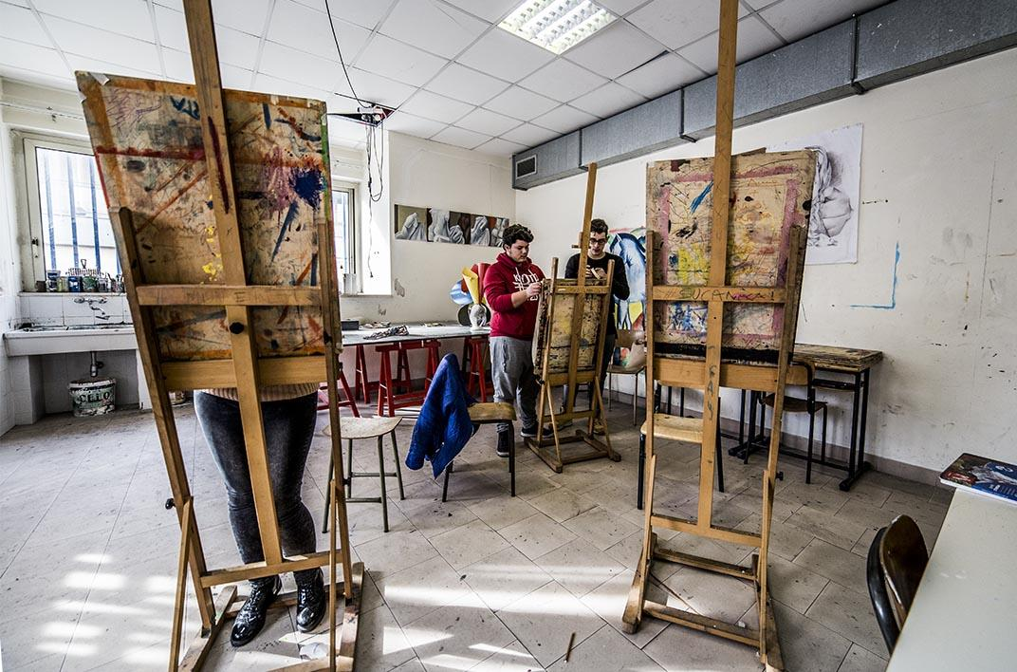
The commitment of each student is always recognized. Students can partecipate to:
free stays abroad;
Cultural and Work-related learning exchanges, such as the Erasmus + project;

Slide 8
Impossible Becomes Possible

