Slide 1
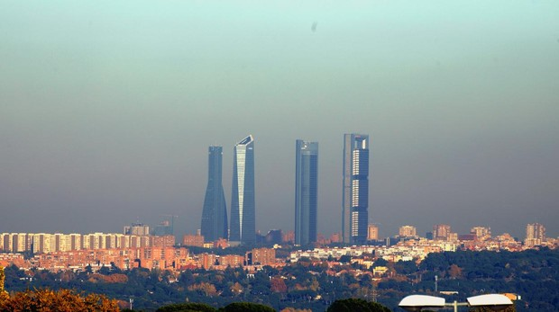
SMOG
Madrid’s SMOG

Slide 2
What is SMOG?
Smog is a word created in the Industrial Revolution, composed by two words:
SMOKE + FOG
It is created by tropospheric ozone, that destroys the ozone layer of our planet.

Slide 3
History of SMOG
It has brought problems to our planet since 1272, when Eduard 1st from England banned the coal burning when the London sky went gray and polluted.
The most important fact in our history that started to bring us the SMOG to our days was the Industrial Revolution. There were lots of factories waste in the rivers and the combustion of coal and other mineral combustibles created the first environment problem of our days.

Slide 4
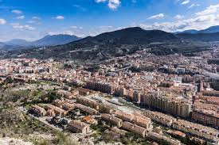
SMOG in our Zone.
In Alcoi, our city, we haven’t got the typical SMOG clouds because we live in a zone surrounded by mountains, with green forests and protected natural areas.
It is not a big city, so there aren’t the same problems of traffic and pollution like in a big city as Madrid or Valencia.

Slide 5
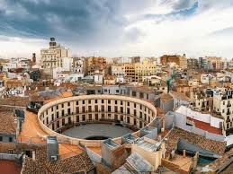
In our nearest capital, Valencia, we can see SMOG clouds very often. It is easier to see it in summer months because there are higher pressures than in winter.
During the Industrial age of Alcoi, the oldest people said to us that the water of our rivers the Serpis or Molinar flowed with different colours by the textile factories dye.

Slide 6
Causes of the SMOG
The smog is created by the industrial gases that have got greenhouse effect, getting accumulated in our atmosphere.
The second important cause of the SMOG is the gas of the vehicles that do not use renewable energies or different types of energy like electricity or solar energy.

Slide 7
How does it affect us?
The SMOG is destroying our ozone layer, raising up the planet temperature and melting our ice poles.
It is increasing the fire risk in forests and burning our oxygen primary source.
SMOG concentrates in the sky of the cities or the places that creates artificial smoke, blocking the clean air to enter to the people and generating breath and vision problems.

Slide 8
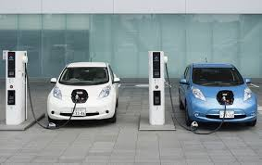
What are we doing to change our world?
Our politicians are changing the laws trying to stop the SMOG radiation and creation in big cities. In our country, it is banned to drive any gas vehicle in the centre of the big cities, forcing people to go walking, on bicycle, by bus or on new electric vehicles for going in the city.
There are green points where people with electric vehicles can connect them to an energy source to recharge it.

Slide 9
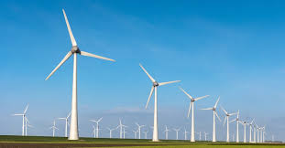
There are windmills around large communities like Castilla la Mancha or Aragón.

Slide 10
What can we do to change our world?
There are more things we are not doing that are necessary to stop the environment destruction.
Spain is one of the sunniest countries of UE, but our politicians don’t want to install more solar panels. It is not woth economically.
When I went to Norway last summer holidays, I was amazed by the immense quantity of electric or hybrid cars I saw. That was a future travel, because in Alcoi there are about 300 electric and hybrid vehicles.
Norway, for example, benefits the electric vehicles owners because their electricity cost is very low by their renewable energy sources.

Slide 11
Our daily movement.
I take a bus to go to school with three more students of my class. There are 18 pupils in my classroom, and there are 4 classes in my course. There are 6 courses, so: 18 x 4 = 72 pupils x 6 = 432 pupils in our high school more or less.
If just 32 pupils, for example and the rest go 2 in the same car, there are 200 cars going to school every day of the week. 200 x 5 = 1000 cars/week.
There are 1000 - 800 cars in a week only in a center. In Alcoi there are more than 15 education centers. 800 x 15 = 12000 cars. Only in Alcoi, we are moving more than 12000 cars every morning to go to study. We need to change this.

Slide 12
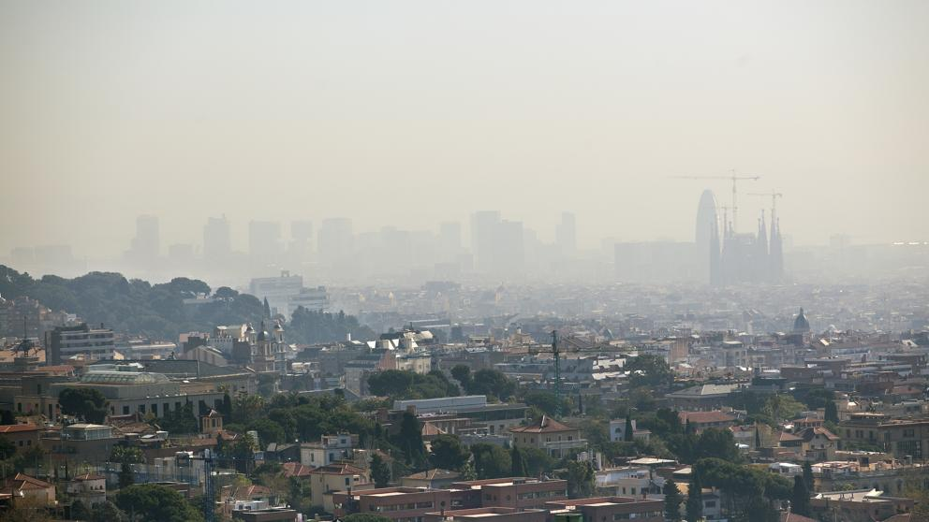
WE NEED TO CHANGE OUR WORLD NOW
THANK YOU

