Slide 1
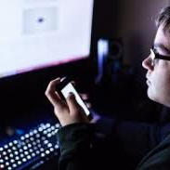
Use of the Internet, computers,
smartphones and other electronic
devices
2021 SURVEY
2nd Lyceum of Kos
Students presenting
Natasha Topi
Aggelos Georgaras
Alexandra Rustem
Mehmet Soumon
Notes:
WE ARE GLAD TO PRESENT YOU A RECENT SURVEY ABOUT THE USE OF THE INTERNET. THE PARTICIPANTS WERE THE STUDENTS OF 2ND LYCEUM OF KOS AND THE STUDENTS PRESENTING NOW ARE NATASHA , AGGELOS , ALEXANDRA AND MEHMET
ALEX

Slide 2
SURVEY TOPICS
Information about the survey
Time spent on the internet
Effects of the Internet time on social and school life
Reliment of our life...the internet
Ineffective organization of time
The most used social network media
Emotions when offline
Notes:
IN THIS PRESENTATION WE WILL INTRODUCE THE FOLLOWING 7 TOPICS
1.
2.
3.
….....................................................
MEXTE

Slide 3
Information about the survey
THE PURPOSE OF THE SURVEY​ | PARTICIPANTS OF THE SURVEY​
ACKNOWLEDGE THE TRUTH ABOUT OUR ONLINE ROUTINE ​ USE THIS INFORMATION ​ MANAGE OUR INTERNET TIME BETTER. ​ | 154 STUDENTS​ AGES 15-19​
Notes:
THE PURPOSE OF THE SURVEY IS TO ACKNOWLEDGE THE TRUTH ABOUT OUR ONLINE ROUTINE AND USE THIS INFORMATION IN OUR FAVIOR. IN OTHER WORDS WE WILL HAVE A BETTER INTERNET TIME MANAGEMENT.
THIS SURVEY CONSISTS OF 154 STUDENTS , RANGING FROM AGES 15 TO 19
AGGELOS

Slide 4
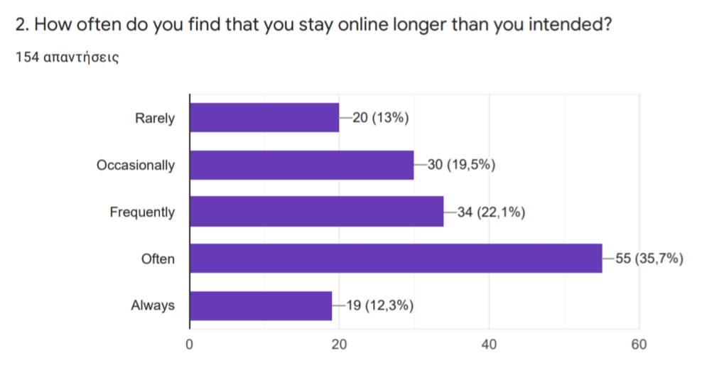
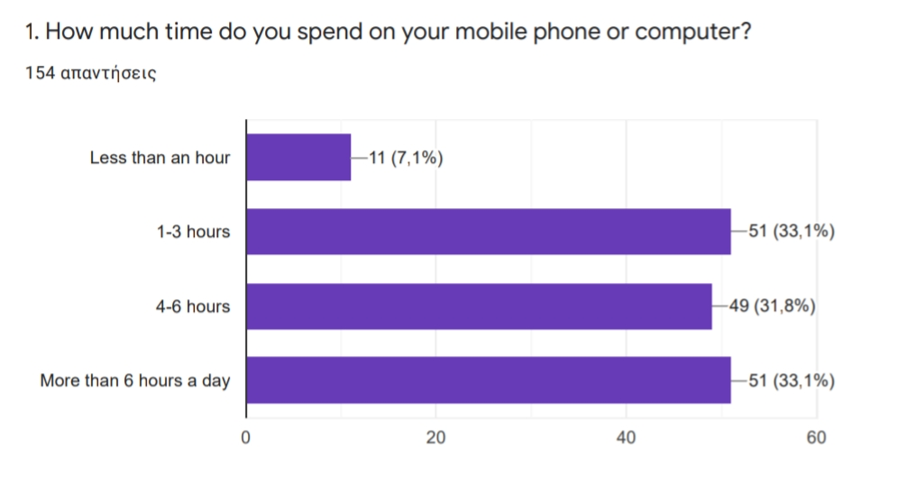
Time spent on the internet
Notes:
NOW WE WILL TALK ABOUT OUR STUDENTS TIME SPENT ON THE INTERNET.
THE FIRST QUESTION ASKED WAS " HOW MUCH TIME DO YOU SPEND ON YOUR PHONE OR COMPUTER?"
ACCORDING TO THE STATISTICS AN EQUAL PRESENTAGE OF STUDENTS SPEND EITHER 1-3 HOURS OR MORE THAN 6 HOURS.
AND THE SECOND QUESTION WAS ABOUT HOW OFTEN DO THEY FIND THEMSELVES STAYING ONLINE LONGER THEN THEY INTENDED.
THE RESULTS SHOW THAT APROXIMATELY 36 PERSENT OF THE PARTICIPANT NOTICE THAT THEY OFTEN SPENT MORE TIME THAN THEY HAD IN MIND.
NATSA

Slide 5
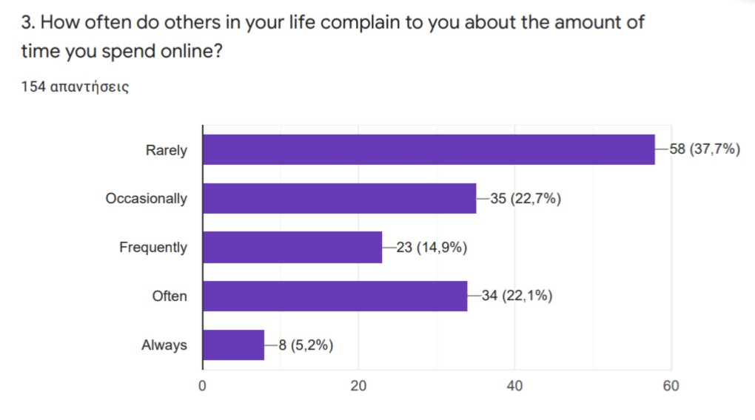
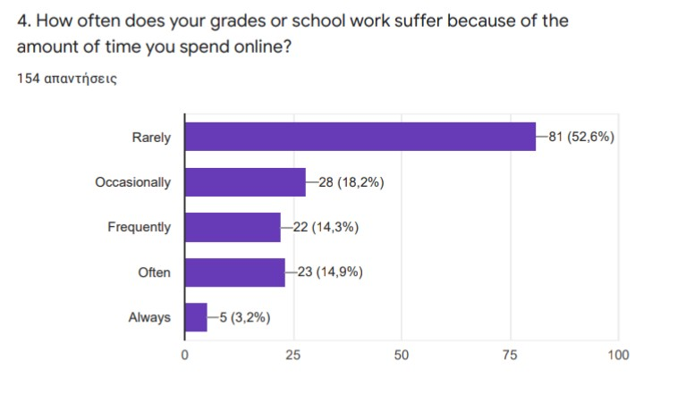
Effects of the Internet time on social and school life
Notes:
Next we will talk about the effects of the internet time on social media and school life
The first question asked how often do others in your life complain to you about the amount of time you spend in social media
The answer key showed us that 37,7% rarely get any complains about their online time.
The second question asked how often does your grades or school work suffer because of the amount of time you spend online
Statistics showed us that 52,6% suffered school work when we were online.
alexandra

Slide 6
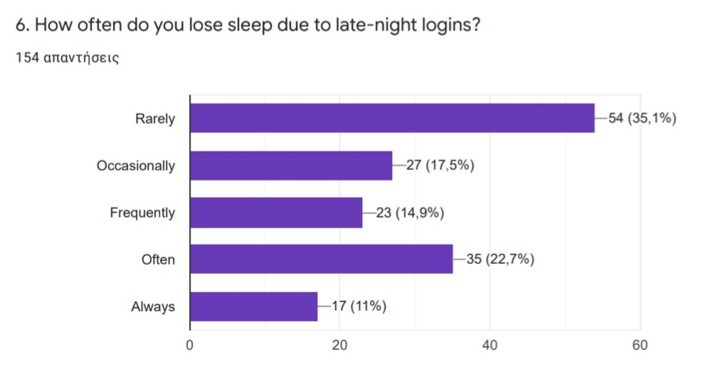
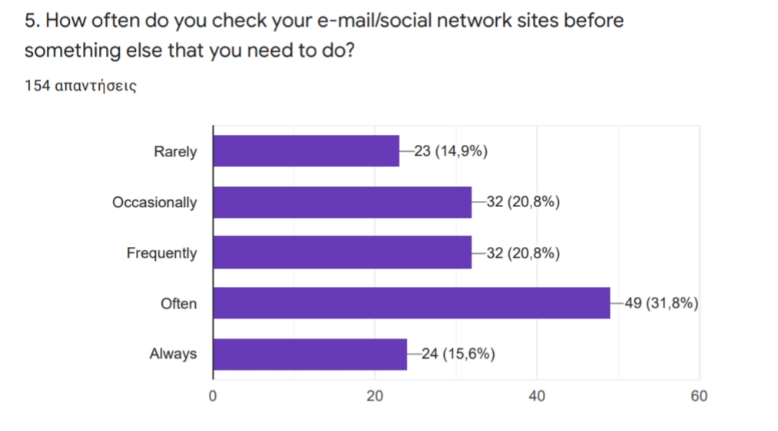
Reliment of our life...the internet
Notes:
In question 5 we asked about how often do you check your email or social network sites before something else that you need to do
The most common answer here was often, while we see the same number of answers in occasionally and frequently.
In question 6 we asked about how often do you lose sleep due to late-night logins
We had a variety of answers, the most common were rarely and often, while some others said occasionally, frequently and always.
MEXMET

Slide 7
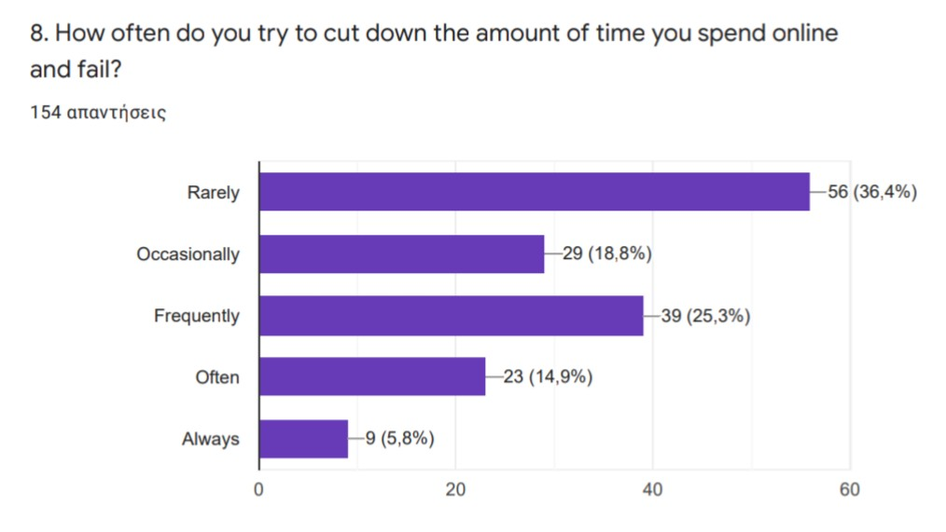
Ineffective organization of time
Notes:
FURTHERMORE WE DISCUSSED ABOUT THE THE INEFFECTIVE ORGANIZATION OF TIME
The query WAS " how often do you try to cut down the amount of time you spent online and fail?"
We concluded that 56 students rarely fail with the thought of cutting down their time and 39 students asweared frequently.
AGELOS

Slide 8
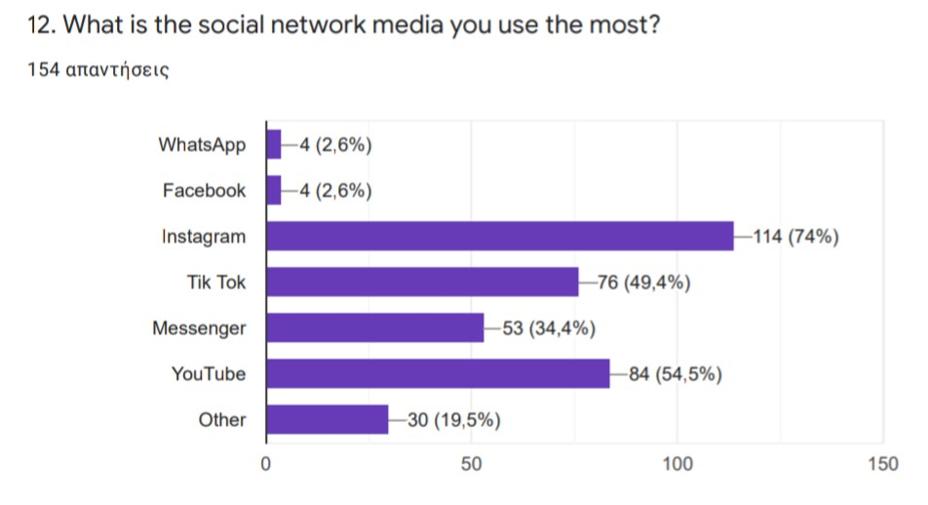
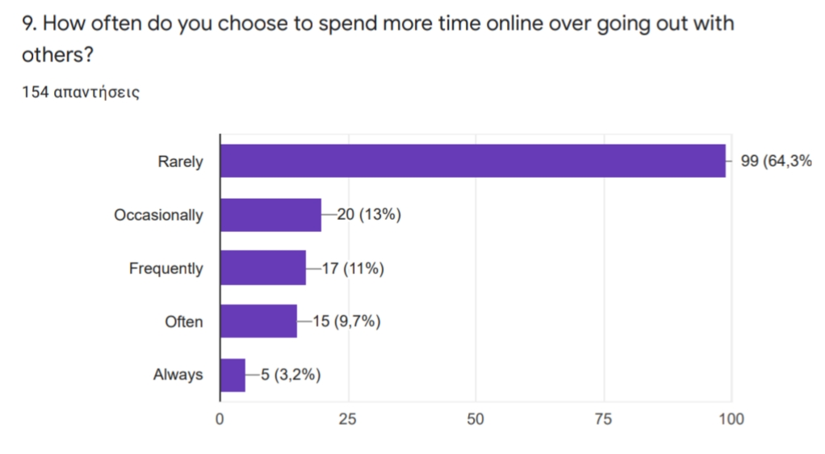
The most used social network media Online or outside?
Notes:
As well we will talk about the most used social network and online or outside preferenceses
The first question asked what is the social media you use the most?
The most famous answer was the instangram with 74%
The second question asked how often do you spend more time online over going out with others?
The counter was 64% spended more time online over went out with others
Alexandra

Slide 9
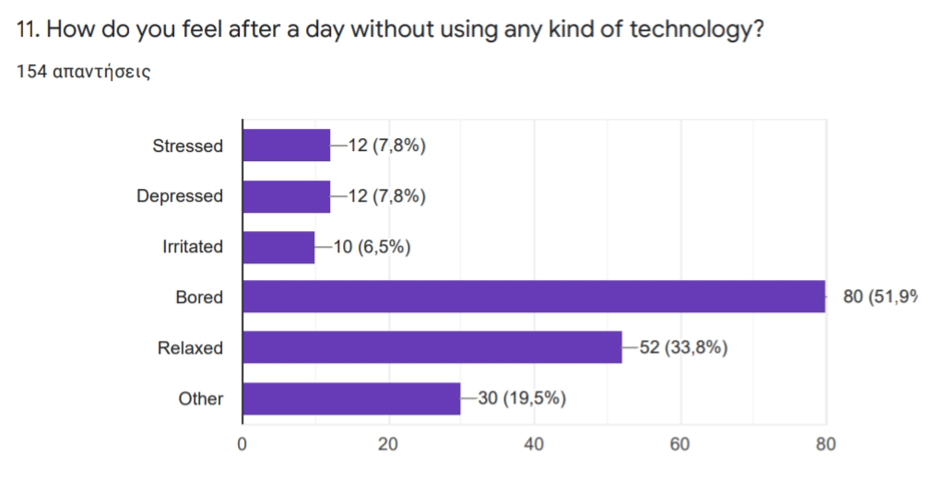
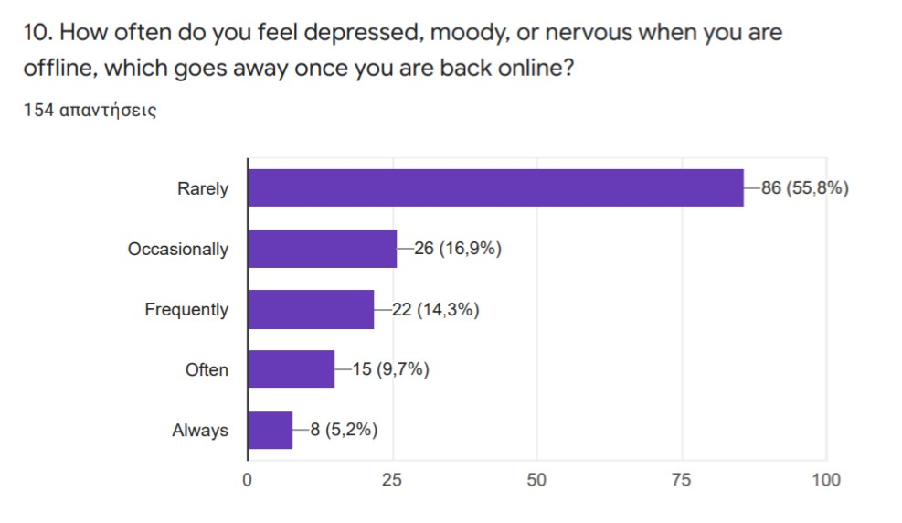
Emotions when offline
Notes:
NOW WE WILL TALK ABOUT OUR STUDENTS TIME SPENT ON THE INTERNET.
THE FIRST QUESTION ASKED WAS " how do you feel after a day without using any kind of technology"
ACCORDING TO THE STATISTICS AN PRESENTAGE OF STUDENTS FEEL BORED
AND THE SECOND QUESTION WAS ABOUT HOW OFTEN DO THEY FEEL DOWN WHEN THEY ARE OFLINE.
THE RESULTS SHOW THAT APROXIMATELY 56% REARLY FEEL DEPRESSED OR MOODY WITHOUT THE INTERNET
AGGELOS

Slide 10
Conclusion
• LOTS OF TIME ONLINE
• LITTLE EFFECT ON OTHER PARTS OF LIFE
• DIFFICULTY MANAGING TIME
• PREFERENCE ON OUTDOOR ACTIVITIES
• MOST USED SOCIAL MEDIA
• NO SERIOUS EMOTIONAL CHANGES
Notes:
ALL IN ALL WE CONCLUDED THAT TEENAGERS SPEND A LOT OF TIME ONLINE BUT IT DOEN'T HVE A LOT OF AFFECTS OF THEUR SOCIAL LIVES MOREOVER WE CAN SEE THAT THEY HAVE DIFFICULTY MANAGING THEIR TIME. THE MOST USED SOCIAL MEDIAS SEEM TO BE INSTAGRAM AND ALSO YOUTUBE /
NEXT WE FOUND OUT THAT THEY PREFER GOING OUTSIDE RATHER THAN STAYING ONLINE .
LASTLY WE DIDN'T INDICATE ANY SERIOUS EMOTIONA;L CHANGES
NATSA

Slide 11
THANK YOU FOR YOUR TIME AND ATTENTION
WE HOPE YOU FOUND THIS PRESENTATION USEFULL
Notes:
<3 big up LMAO
natashaaaa

